Slide 1

MINDWARE
Seed Labels & Seed Certification Tags in India - The Complete Guide
What the law requires, tag colours and sizes, SATHI QR traceability - and the tags, labels and printers to do it right
Indian RFID - Mindware, New Delhi | From consultation to implementation
www.indianrfid.com/seed-labels-india | +91-9717122688 | gm@indianbarcode.com

Slide 2
1. The law: Seeds Act, Seeds Rules and Seeds (Control) Order
MINDWARE
• Seed labelling in India is governed by the Seeds Act, 1966 and the Seeds Rules, 1968 . Section 6(b) of the Act lets the Government notify the particulars that seed of notified kinds and varieties must carry, and Section 7 makes it an offence to sell such seed...
• Rule 7 - the person whose name is on the label is responsible for its accuracy while the container is unopened (but not for germination after the...
• Rule 8 - the contents of the label (see the next section).
• Rule 9 - the label goes on the innermost container and on every covering; it may instead be marked indelibly on the container.
• Rules 10-12 - no false or misleading statements and no disclaimers on the label.
• Rule 13 - seed may not be sold after the validity date, labels must not be defaced, and records must be kept for three years.
• Rule 17 and Form II - the certification tag and seal used by certification agencies.
Indian RFID - Mindware | www.indianrfid.com | +91-9717122688 | gm@indianbarcode.com

Slide 3
1. The law: Seeds Act, Seeds Rules and Seeds (Control) Order (cont.)
MINDWARE
• The Seeds (Control) Amendment Order, 2006 (clause 8A) extends this: every dealer, including dealers in non-notified seed, must meet the Section 6 standards and any further standards for the size, colour and content of the label . A new Seeds Bill proposing QR...
Indian RFID - Mindware | www.indianrfid.com | +91-9717122688 | gm@indianbarcode.com

Slide 4
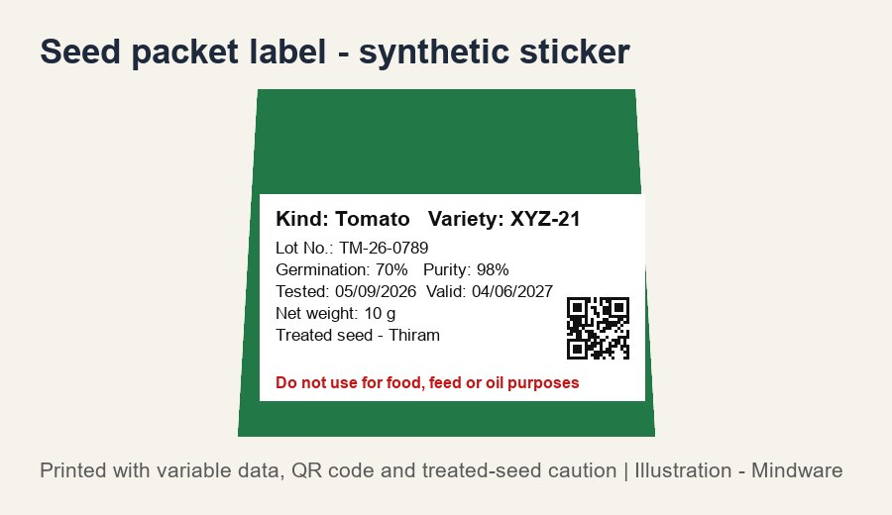
2. What must be printed on a seed label
MINDWARE
• Under Rule 8 of the Seeds Rules, the label must carry the particulars notified under Section 6(b) of the Act and the following details. In practice a seed label or tag shows:
• Kind and variety - Crop / kind and the variety name as notified
• Lot number - The seed lot identification
• Germination - Percentage, not below the notified minimum
• Physical purity - Percentage of pure seed
• Genetic purity - Where notified for the crop
• Date of test and validity - Date of testing; valid-up-to date
Indian RFID - Mindware | www.indianrfid.com | +91-9717122688 | gm@indianbarcode.com

Slide 5
2. What must be printed on a seed label (cont.)
MINDWARE
• The detailed list of notified particulars comes from Section 6(b) notifications and state guidance - always confirm the current list for your crop with your State Seed Certification Agency or seed inspector.
Indian RFID - Mindware | www.indianrfid.com | +91-9717122688 | gm@indianbarcode.com

Slide 6
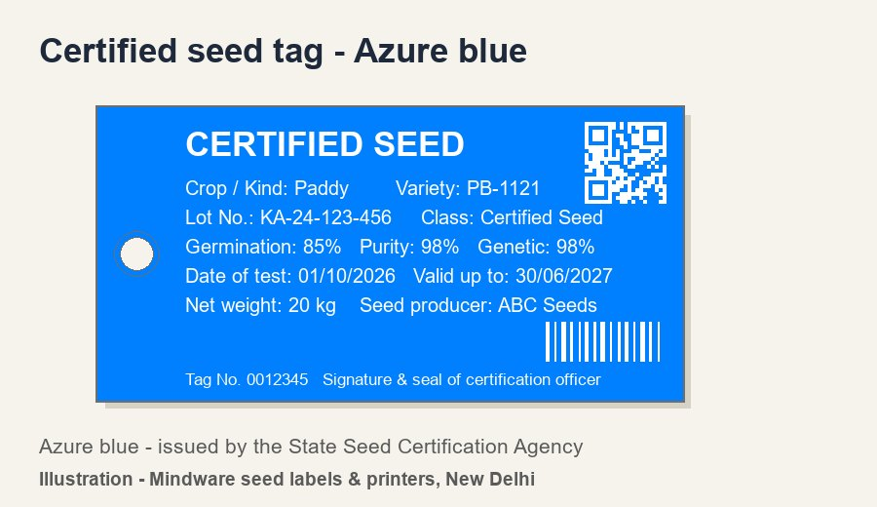
3. Seed tag colours by class
MINDWARE
• Breeder seed - Golden yellow label (cloth-lined, 12 x 6 cm) - The breeder / institute producing breeder seed
• Foundation seed - White tag (both sides) - State Seed Certification Agency
• Certified seed - Azure blue tag (both sides) - State Seed Certification Agency
• Truthfully labelled (TL) seed - Opal green tag - The seed producer (no certification agency)
• Colours as given in the Indian Minimum Seed Certification Standards and ICAR guidance. Older Seeds Rules text also mentions a purple tag for "registered" seed, a class not used in the current standards.
Indian RFID - Mindware | www.indianrfid.com | +91-9717122688 | gm@indianbarcode.com

Slide 7
4. Size, material and attaching tags
MINDWARE
• Certification tag size: 15 cm x 7.5 cm, which may be reduced in proportion for small containers (Indian Minimum Seed Certification Standards 2013...
• Breeder seed label: 12 cm x 6 cm, cloth-lined.
• Material: the standards allow thick paper, paper with cloth lining, wax-coated or plastic-coated paper. Many companies now use tear-proof synthetic...
• Attaching: tags are stitched or sealed to the bag; certification tags carry the signature and stamp of the certification official on the back.
• Small packets: vegetable and flower seed packets usually carry a printed self-adhesive label or are printed directly with the required particulars.
Indian RFID - Mindware | www.indianrfid.com | +91-9717122688 | gm@indianbarcode.com

Slide 8
5. Validity and re-validation tagging
MINDWARE
• Certified seed is valid for 9 months from the date of test , and can be extended by 6 months at a time after each successful re-test. On re-validation the new date and the agency are stamped on the existing tags; if a lot is re-bagged, new tags are issued...
Indian RFID - Mindware | www.indianrfid.com | +91-9717122688 | gm@indianbarcode.com

Slide 9
6. SATHI, QR codes and traceability
MINDWARE
• SATHI - Seed Authentication, Traceability & Holistic Inventory - is the Government of India seed traceability portal (seedtrace.gov.in), launched in April 2023 . Phase I covers the seed chain from nucleus and breeder seed to foundation and certified seed...
• Several states and crops (for example Bt cotton packets) have also introduced QR requirements. The exact QR content and format come from the portal and your state agency, so check the current instructions before designing tags - and choose tag stock and...
Indian RFID - Mindware | www.indianrfid.com | +91-9717122688 | gm@indianbarcode.com

Slide 10
7. Seed tags and labels we make
MINDWARE
• Buy plain seed labels from us - blank seed tags and labels in azure blue, white, golden yellow and opal green, on rolls for your barcode printer. You print the lot data yourself; we supply the labels, ribbons and printer.
• Plain (blank) seed labels and tags - in all four colours, ready to print on your own thermal transfer printer.
• Seed certification and TL tags in white, azure blue, golden yellow and opal green - 15 x 7.5 cm and custom sizes, with eyelet / hole for stitching.
• Tear-proof synthetic tag stock (PP / PET) and coated paper options, pre-printed with your fixed design.
• Seed packet labels - self-adhesive labels for pouches, tins and boxes, with the treated-seed caution in red where needed.
• Variable-data printing - lot number, test date, validity, germination, purity, serial numbers, barcodes and QR codes.
• Rolls or fan-fold to run on desktop and industrial barcode printers; stock dies from our die list , new sizes on request.
Indian RFID - Mindware | www.indianrfid.com | +91-9717122688 | gm@indianbarcode.com

Slide 11
8. Printers, ribbons and scanners
MINDWARE
• Seed companies usually keep pre-printed coloured tags in stock and print the variable data in-house, lot by lot. For this we supply:
• Thermal transfer barcode printers - 4-inch desktop and industrial models from TSC , Zebra , GoDEX and others (paid service and AMC available).
• Resin ribbons (Mynds) for smudge-proof, water-resistant print on synthetic tags.
• Label software to print lot data and QR codes from Excel or your ERP.
• 2D barcode scanners and mobile computers to scan QR codes at the warehouse and dealer.
• See also: types of barcode labels · types of barcode scanners · warehouse solutions
Indian RFID - Mindware | www.indianrfid.com | +91-9717122688 | gm@indianbarcode.com

Slide 12
Indian RFID - Mindware: from consultation to implementation
MINDWARE
1
Consultation
2
Site survey
3
Pilot
4
Supply
5
Encoding & software
6
Installation & training
7
Support & AMC
Mindware (New Delhi, since 1997) and its RFID division Indian RFID take your project from the first conversation to a working system - and support it after go-live.
Phone / WhatsApp: +91-9717122688 Email: gm@indianbarcode.com
S-4, Pankaj Plaza, Pocket-7, Plot-7, Dwarka Sector-12, New Delhi - 110078
www.indianrfid.com | Free guides: www.indianrfid.com/whitepapers
Indian RFID - Mindware | www.indianrfid.com | +91-9717122688 | gm@indianbarcode.com

