Slide 1

MINDWARE
Which RFID Chip for Which Application
Choosing the right RFID chip and tag is the single most important technical decision in a project. This chapter maps common applications to frequency, tag type and example chips, lists the questions to ask before you choose, and...
Indian RFID - Mindware, New Delhi | From consultation to implementation
www.indianrfid.com/rfid-academy/which-rfid-chip-to-use | +91-9717122688 | gm@indianbarcode.com

Slide 2
Start with the application, not the chip
MINDWARE
• A common question to RFID suppliers is "Which is the best chip?" There is no single best chip - only the best chip for a given job . A chip that is ideal for apparel labels may be useless on a metal server rack, and a secure NFC chip is wasted on a carton...
• The right order of decisions is:
• Define the job: what is tagged, how many items, how far away, how fast, and who or what reads it (fixed reader, handheld, smartphone).
• Choose the frequency band: LF, HF/NFC or UHF, based on range, environment and reader type. See RFID Frequencies for the physics.
• Choose the tag form: paper label, wet inlay, on-metal hard tag, laundry tag, card, wristband, windshield sticker and so on. The Types of RFID Tags...
• Choose the chip inside: based on memory, security, sensitivity and compatibility with your ecosystem (for example a retailer's approved list).
• Test the finished tags on real items before buying in volume.
Indian RFID - Mindware | www.indianrfid.com | +91-9717122688 | gm@indianbarcode.com

Slide 3
Start with the application, not the chip (cont.)
MINDWARE
• The chip families named in this chapter are explained in RFID Chips Explained . The examples below are typical choices, not the only correct ones; many equivalent chips exist.
Indian RFID - Mindware | www.indianrfid.com | +91-9717122688 | gm@indianbarcode.com

Slide 4
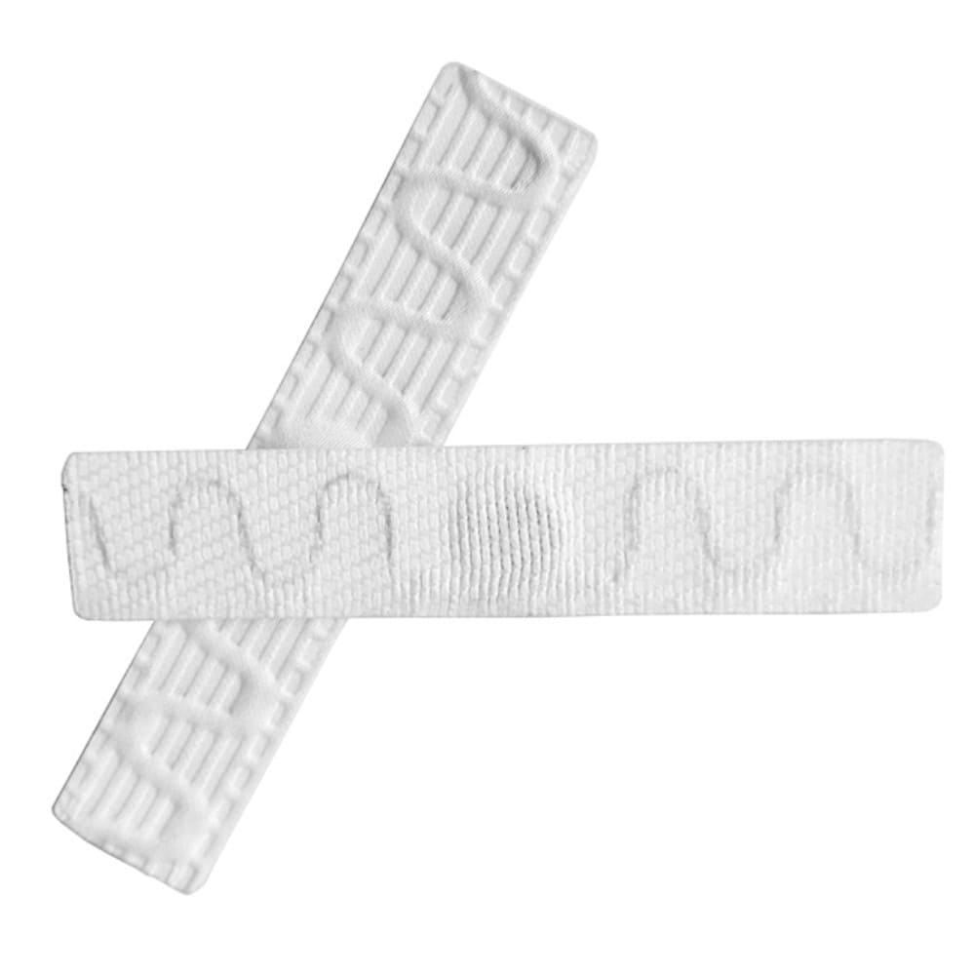
Application selection table
MINDWARE
• Retail apparel and footwear - UHF (EPC Gen2) - Hang tags, care labels, sticker labels - Impinj M730/M750, NXP UCODE 8/9, Alien Higgs-10 - Fast bulk...
• Warehouse cartons and pallets - UHF - Paper face labels, often printed with barcode too - Monza R6 family, M700, UCODE 8/9 - Reads at dock doors and...
• Jewellery - UHF - Small tail/dumbbell tags tied to each piece - Impinj M700, UCODE 9 - Counting hundreds of pieces in minutes; tag stays on the item...
• Library books - HF (ISO 15693) or UHF - Thin book labels - ICODE SLIX2 (HF); UCODE / Monza (UHF) - HF has the established ISO 28560 library data...
• Pharma and anti-counterfeit - HF/NFC or UHF - Labels, tamper-evident seals - NTAG 424 DNA, ICODE DNA, UCODE DNA - Cryptographic authentication proves...
• Access control and cashless - HF (ISO 14443A) - PVC cards, key fobs, wristbands - MIFARE DESFire EV2/EV3 - AES-128 security, multi-application; avoid...
• Finished tags for most of these applications are available in our UHF RFID labels , NFC tags, RFID hard tags , wristbands and cards ranges.
Indian RFID - Mindware | www.indianrfid.com | +91-9717122688 | gm@indianbarcode.com

Slide 5
Notes on key applications
MINDWARE
• Retail and supply chain
• Retail tagging is driven by volume and cost. Most retail programmes specify UHF EPC Gen2 labels with a serialised GTIN (SGTIN-96) in the EPC bank and no need for user memory.
• Jewellery
• Gold and silver are metals, but jewellery tags work because the small UHF tag hangs from the piece on a thread rather than sitting flat on a large metal surface. Showrooms count trays and safes with handhelds and use RFID-enabled counters for sales.
• Library
• Many libraries worldwide use HF ISO 15693 tags with ICODE SLIX2 and the ISO 28560 data model, which gives good self-checkout and security-gate performance. UHF is increasingly chosen for new libraries because it speeds up shelf audits.
• Pharma and brand protection
Indian RFID - Mindware | www.indianrfid.com | +91-9717122688 | gm@indianbarcode.com

Slide 6
Notes on key applications (cont.)
MINDWARE
• A serial number alone does not stop counterfeiters - they can copy a readable number onto a fake tag. Real authentication needs a chip that performs a cryptographic challenge-response, such as NTAG 424 DNA (consumers tap with a phone and a server validates...
• Animal identification
• Animal ID uses LF at 134.2 kHz under ISO 11784 (code structure) and ISO 11785 (air interface). FDX-B is the dominant protocol for pets and livestock.
• Vehicles and FASTag
• Vehicle tags must be read at speed through windscreen glass. FASTag, India's electronic toll system, uses passive UHF EPC Gen2 windshield stickers that break if peeled off, preventing transfer between vehicles.
• Laundry, tyres and solar panels
• These are "hostile environment" applications. Laundry tags face high temperature, pressure from presses and harsh chemicals for hundreds of wash cycles.
Indian RFID - Mindware | www.indianrfid.com | +91-9717122688 | gm@indianbarcode.com

Slide 7
Questions to ask before choosing
MINDWARE
• Work through these questions with your supplier or integrator. The answers usually make the chip choice obvious.
• What is the item made of? Metal, liquids, foil packaging, carbon fibre and dense materials all affect UHF performance.
• How far is the reader? A few centimetres (tap), up to a metre (desk or gate), or several metres (dock door, ceiling)?
• How many tags must be read at once, and how fast? Bulk reading of hundreds of items favours UHF.
• Who reads the tag? Your own fixed or handheld readers, your customers' smartphones, or partner systems such as a retailer or toll operator?
• Is security required? Is it enough to identify the item, or must you prove it is genuine or control who can write data?
• How much data must be on the tag? A unique ID linked to a database is usually best. Choose user memory only when data must be available offline.
Indian RFID - Mindware | www.indianrfid.com | +91-9717122688 | gm@indianbarcode.com

Slide 8
Questions to ask before choosing (cont.)
MINDWARE
• What is the environment and lifetime? Temperature, washing, outdoor UV, chemicals, impact and expected service life.
• How will tags be applied and encoded? Printed on an RFID printer, pre-encoded by the supplier, or encoded on site?
• Which region? Tags used in India should be tuned for 865-867 MHz; export items may need global 860-960 MHz tuning.
• What volume and budget? Indicative costs range from a few rupees for simple UHF inlays in high volume to several hundred rupees or more for rugged...
• Tip: Ask for 20-50 samples of two or three shortlisted tags and test them on your actual items with your intended reader. Real samples beat datasheet numbers every time.
Indian RFID - Mindware | www.indianrfid.com | +91-9717122688 | gm@indianbarcode.com

Slide 9
Rules of thumb by band
MINDWARE
• Choose UHF when you need range beyond about one metre, bulk reading, or integration with retail and logistics standards. Pay attention to metal and...
• Choose HF/NFC when the read should be deliberate and close, when consumers will use smartphones, or when you need mature, certified security for...
• Choose LF for animals, for operation very close to metal or in water, and where existing readers and standards require it.
• Consider dual-frequency tags (UHF plus NFC) when the same item must be read in the warehouse and by consumers.
Indian RFID - Mindware | www.indianrfid.com | +91-9717122688 | gm@indianbarcode.com

Slide 10
Common mistakes
MINDWARE
• Watch out: The most expensive mistake is ordering thousands of tags based on a datasheet or a demo on a desk, then discovering they do not read on the real product. Always test first.
• Using a standard UHF label on metal or liquid-filled items. It will detune and fail. Use on-metal tags or tags designed for the material.
• Choosing a chip for its maximum memory "just in case". More memory usually means higher cost and sometimes lower sensitivity. Store data in the...
• Treating a readable serial number as security. EM4100 cards, MIFARE Classic and plain UHF EPCs can be copied. Use AES-based chips where security...
• Ignoring region tuning. A tag optimised for 915 MHz may lose noticeable range at 866 MHz.
• Mixing bands without a plan. An HF library tag cannot be read by UHF gates. Decide the band for the whole system.
• Not locking tags. Leaving EPC memory unlocked with default passwords invites accidental or malicious rewriting.
Indian RFID - Mindware | www.indianrfid.com | +91-9717122688 | gm@indianbarcode.com

Slide 11
Common mistakes (cont.)
MINDWARE
• Forgetting the encoding workflow. Plan how tags will be printed and encoded - see RFID Printing & Encoding .
• If you are still unsure, an independent tag selection and test exercise is one of the most valuable services in an RFID project. Our RFID consulting team can run sample tests on your items and recommend a tag shortlist with measured results.
Indian RFID - Mindware | www.indianrfid.com | +91-9717122688 | gm@indianbarcode.com

Slide 12
Indian RFID - Mindware: from consultation to implementation
MINDWARE
1
Consultation
2
Site survey
3
Pilot
4
Supply
5
Encoding & software
6
Installation & training
7
Support & AMC
Mindware (New Delhi, since 1997) and its RFID division Indian RFID take your project from the first conversation to a working system - and support it after go-live.
Phone / WhatsApp: +91-9717122688 Email: gm@indianbarcode.com
S-4, Pankaj Plaza, Pocket-7, Plot-7, Dwarka Sector-12, New Delhi - 110078
www.indianrfid.com | Free guides: www.indianrfid.com/whitepapers
Indian RFID - Mindware | www.indianrfid.com | +91-9717122688 | gm@indianbarcode.com

