Slide 1

MINDWARE
RFID Standards & Regulations
RFID only works at scale because tags, readers and software from different makers follow the same rules. This chapter maps the key air-interface and data standards for LF, HF, NFC and UHF, and explains the radio regulations that...
Indian RFID - Mindware, New Delhi | From consultation to implementation
www.indianrfid.com/rfid-academy/rfid-standards | +91-9717122688 | gm@indianbarcode.com

Slide 2
Why RFID standards matter
MINDWARE
• Imagine buying 10 lakh UHF labels from one supplier, readers from a second and software from a third, and finding that nothing talks to anything else. In the early 2000s that was a real risk: many RFID systems used proprietary protocols, and a tag from one...
• Standards give you four practical benefits:
• Interoperability - tags, readers, printers and middleware from different vendors work together.
• Choice and price competition - you are not locked into a single supplier for consumables, which matters because tags are a recurring cost.
• Data sharing - trading partners can understand each other's tag data without custom translation.
• Legal compliance - radio regulations tell you which frequencies and power levels you may use, and certified equipment respects them.
• Before going further, revise the basics of RFID frequencies if needed, because almost every standard is tied to one frequency band.
Indian RFID - Mindware | www.indianrfid.com | +91-9717122688 | gm@indianbarcode.com

Slide 3
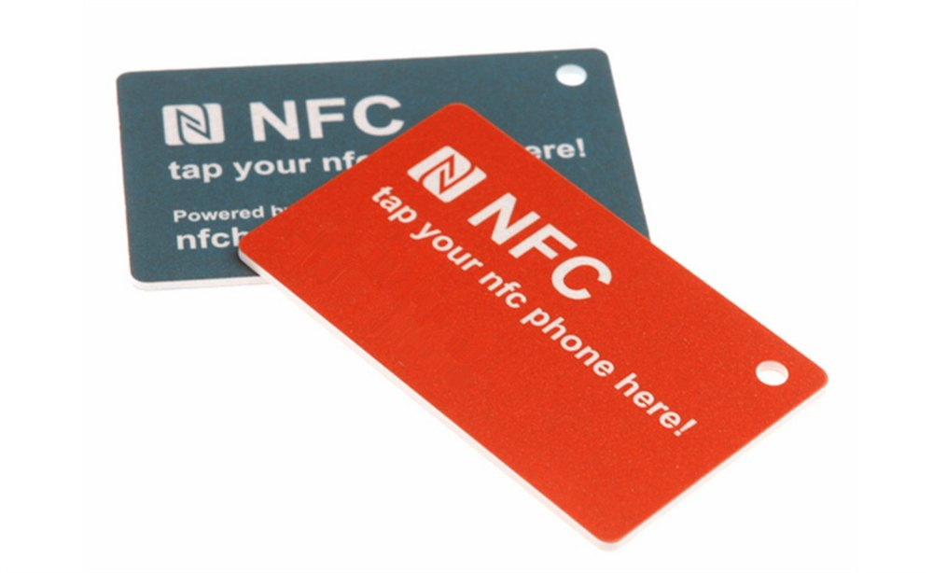
Air-interface standards vs data standards
MINDWARE
• The single most useful idea in this chapter is that RFID standards come in two layers, and you need both.
• Air-interface (protocol) standards
• These define how a reader and a tag communicate over the radio: the carrier frequency, modulation and encoding, data rates, the command set (Query, Read, Write, Lock and so on) and the anti-collision method used to read many tags at once. EPC Gen2, ISO/IEC...
• Data (content) standards
• These define what those bits mean: how a product number, serial number, asset ID or library item ID is laid out in memory. The GS1 EPC Tag Data Standard, ISO 28560 for libraries and ISO 11784 for animal ID are data standards.
• Example: A warehouse reader and a retailer's handheld both speak EPC Gen2, so each can read the other's tags. But if the warehouse wrote a home-made 12-digit code into the EPC bank while the retailer expects a GS1 SGTIN-96, the retailer's software will read...
• There is also a third, higher layer: system and software standards such as LLRP (how software controls a reader) and EPCIS (how business events are shared). We touch on these below and cover them fully in RFID Middleware & Software .
Indian RFID - Mindware | www.indianrfid.com | +91-9717122688 | gm@indianbarcode.com

Slide 4
UHF: EPC Gen2, Gen2v2 and ISO/IEC 18000-63
MINDWARE
• Passive UHF RFID (860-960 MHz) is dominated by one protocol: the EPCglobal UHF Class 1 Generation 2 air interface, usually just called Gen2 . It was developed by EPCglobal, now part of GS1, and ratified in 2004.
• Gen2 introduced features that made large-scale UHF practical:
• A slotted, probabilistic anti-collision method (the Q algorithm) that lets a reader inventory hundreds of tags per second.
• Sessions (S0-S3) and inventoried flags, so multiple readers can work in the same area and tags already counted can stay quiet.
• Four memory banks (Reserved, EPC, TID, User) - explained in EPC Encoding & Tag Memory .
• Select commands to address subsets of tags, plus Lock and Kill commands with 32-bit passwords.
• Dense reader modes to reduce interference where many readers operate together.
Indian RFID - Mindware | www.indianrfid.com | +91-9717122688 | gm@indianbarcode.com

Slide 5
UHF: EPC Gen2, Gen2v2 and ISO/IEC 18000-63 (cont.)
MINDWARE
• Gen2v2
• Version 2.0 of the specification, released in 2013 and commonly called Gen2v2 , is backward compatible with Gen2 and adds optional security and privacy features: an Untraceable command that lets a tag hide part of its EPC, TID or user memory and reduce its...
• RAIN RFID
• RAIN RFID is not a separate technology. It is the brand name used by the RAIN RFID Alliance, an industry group formed in 2014 to promote passive UHF RFID based on Gen2 / ISO/IEC 18000-63.
• Tip: India's FASTag electronic toll system uses passive UHF tags built on this same Gen2 / ISO 18000-63 family, which is one reason it could scale to crores of vehicles with tags and readers from many manufacturers.
Indian RFID - Mindware | www.indianrfid.com | +91-9717122688 | gm@indianbarcode.com

Slide 6
HF and NFC standards (13.56 MHz)
MINDWARE
• High frequency RFID at 13.56 MHz has several standards, and choosing the right one depends on range and use case.
• ISO/IEC 14443 (proximity cards)
• ISO/IEC 14443 covers contactless proximity cards with a working range of typically a few centimetres, up to about 10 cm. It comes in two variants, Type A and Type B , which differ in modulation and anti-collision but serve the same purpose.
• ISO/IEC 15693 (vicinity cards)
• ISO/IEC 15693 is designed for longer HF ranges - typically up to around a metre with a large reader antenna, and much less with handheld readers or small tags. It is popular for library books, laundry, pharmaceutical items, access cards and industrial labels.
• ISO/IEC 18000-3
• The ISO/IEC 18000 series defines air interfaces by frequency. Part 3 covers 13.56 MHz and includes modes that align with ISO/IEC 15693 (Mode 1) and a faster mode designed for item-level use (Mode 3).
Indian RFID - Mindware | www.indianrfid.com | +91-9717122688 | gm@indianbarcode.com

Slide 7
HF and NFC standards (13.56 MHz) (cont.)
MINDWARE
• NFC Forum standards
• NFC (Near Field Communication) is a subset of HF RFID. It is defined by ISO/IEC 18092 and the specifications of the NFC Forum , which also define the NDEF message format used to store URLs, text and other records.
• Type 1 - ISO/IEC 14443 A - Early low-memory tags; rarely used today
• Type 2 - ISO/IEC 14443 A - NTAG21x, MIFARE Ultralight - posters, labels, smart packaging
• Type 3 - FeliCa (JIS X 6319-4) - Common in Japan for transit and payments
• Type 4 - ISO/IEC 14443 A/B with ISO 7816-4 commands - MIFARE DESFire, NTAG 424 DNA - secure and authenticated tags
• Type 5 - ISO/IEC 15693 (NFC-V) - ICODE SLIX family - longer-range HF labels readable by phones
Indian RFID - Mindware | www.indianrfid.com | +91-9717122688 | gm@indianbarcode.com

Slide 8
LF standards for animal identification
MINDWARE
• Low frequency RFID (roughly 125-134.2 kHz) is the global choice for animal identification because LF penetrates tissue and water well. Three ISO standards matter:
• ISO 11784 - the code structure: a 64-bit identifier that includes a country code (or manufacturer code) and a unique national identification number...
• ISO 11785 - the technical concept: operation at 134.2 kHz and two transmission methods, FDX-B (full duplex) and HDX (half duplex). A compliant reader...
• ISO 14223 - advanced transponders that extend 11784/11785 with additional memory and read/write functions while staying backward compatible.
• These are used for pet microchips, cattle ear tags, rumen boluses and wildlife tracking. Wherever a livestock or pet identification programme uses RFID, in India or abroad, ISO 11784/11785 compliance is the normal requirement.
• Watch out: Many cheap 125 kHz access cards (EM4100-style and similar) are not ISO 11784/11785 devices and are not interchangeable with animal tags, even though both are "LF RFID". Always check which standard a product actually follows.
Indian RFID - Mindware | www.indianrfid.com | +91-9717122688 | gm@indianbarcode.com

Slide 9
Data standards: GS1 EPC TDS, ISO 28560 and others
MINDWARE
• GS1 EPC Tag Data Standard (TDS)
• The GS1 EPC Tag Data Standard defines how GS1 identifiers are encoded in the EPC memory bank of a UHF tag. It specifies schemes such as SGTIN (serialised trade items - a GTIN plus serial number), SSCC (logistics units such as pallets), SGLN (locations), GRAI...
• A companion GS1 standard, the Tag Data Translation (TDT) standard, provides machine-readable rules for converting between binary, URI and barcode forms.
• ISO 28560 for libraries
• ISO 28560 defines a data model for RFID in libraries: which data elements exist (primary item identifier, owner library, set information and more) and how they are encoded. Earlier parts focus on HF ISO/IEC 15693 tags; a later part addresses encoding on UHF...
• Other data and application standards
• ISO/IEC 15961 and 15962 - a general data protocol for encoding data objects on RFID tags.
Indian RFID - Mindware | www.indianrfid.com | +91-9717122688 | gm@indianbarcode.com

Slide 10
Data standards: GS1 EPC TDS, ISO 28560 and others (cont.)
MINDWARE
• ISO 17363 to 17367 - supply chain applications of RFID, from freight containers down to product tagging.
• ISO/IEC 18046 and 18047 - test methods for tag/reader performance and conformance.
• EPCIS (ISO/IEC 19987) and the Core Business Vocabulary (ISO/IEC 19988) - for sharing "what, when, where, why" events between trading partners.
• LLRP - the EPCglobal Low Level Reader Protocol for controlling readers from software.
Indian RFID - Mindware | www.indianrfid.com | +91-9717122688 | gm@indianbarcode.com

Slide 11
UHF regulations: India, Europe, the US and beyond
MINDWARE
• LF and HF bands (125-134 kHz and 13.56 MHz) are available almost everywhere. UHF is different: each country allocates its own slice of the 860-960 MHz range and sets its own power limits.
• India - 865-867 MHz - Licence-exempt under WPC (Department of Telecommunications) - No frequency licence needed; limits typically 1 W transmitter...
• Europe (EU/EEA and many others) - 865-868 MHz - ETSI EN 302 208 - Four high-power channels of 200 kHz around 865.7, 866.3, 866.9 and 867.5 MHz, up to...
• United States, Canada - 902-928 MHz - FCC Part 15 (US), ISED (Canada) - Frequency hopping across many channels; up to 1 W conducted and 4 W EIRP.
• China - 920-925 MHz (also 840-845 MHz) - National radio regulator - Separate allocation; global tags are needed for export flows.
• Japan - Around 916-921 MHz - National radio regulator - Specific channel plan and licensing categories.
• The Indian band sits inside the European band, so many European-region readers can be configured for India. Always confirm with your supplier that the specific model is approved and set to the Indian region.
Indian RFID - Mindware | www.indianrfid.com | +91-9717122688 | gm@indianbarcode.com

Slide 12
UHF regulations: India, Europe, the US and beyond (cont.)
MINDWARE
• What this means for tags
• Passive UHF tags do not transmit on their own, so they are not licensed in the same way, but their antenna is tuned. "Global" inlays are designed to perform acceptably from 860 to 960 MHz; some inlays are optimised for either the EU/India band or the US band.
Indian RFID - Mindware | www.indianrfid.com | +91-9717122688 | gm@indianbarcode.com

Slide 13
How to use standards when planning a project
MINDWARE
• Pick the frequency and air interface first. Bulk reading of cartons and assets points to UHF Gen2; phone interaction points to NFC; animals point to...
• Pick the data standard next. If items move between companies, use GS1 EPC schemes with your own GS1 Company Prefix rather than a home-made numbering...
• Check regional rules for every country where you will read the tags, and buy readers certified for those regions.
• Specify standards in purchase orders - for example "ISO/IEC 18000-63 compliant inlay, global band, SGTIN-96 encoded, TID serialised".
• Verify, do not assume. Test samples from each supplier with your actual readers and software before a large order.
• Tip: Writing standards into your specification is the cheapest protection against vendor lock-in. If a supplier's product is "Gen2-compatible but needs our software", ask exactly which parts are proprietary.
• If you are unsure which standard fits your use case, our RFID consulting team can review your requirements and regional constraints with you.
Indian RFID - Mindware | www.indianrfid.com | +91-9717122688 | gm@indianbarcode.com

Slide 14
Indian RFID - Mindware: from consultation to implementation
MINDWARE
1
Consultation
2
Site survey
3
Pilot
4
Supply
5
Encoding & software
6
Installation & training
7
Support & AMC
Mindware (New Delhi, since 1997) and its RFID division Indian RFID take your project from the first conversation to a working system - and support it after go-live.
Phone / WhatsApp: +91-9717122688 Email: gm@indianbarcode.com
S-4, Pankaj Plaza, Pocket-7, Plot-7, Dwarka Sector-12, New Delhi - 110078
www.indianrfid.com | Free guides: www.indianrfid.com/whitepapers
Indian RFID - Mindware | www.indianrfid.com | +91-9717122688 | gm@indianbarcode.com

