Slide 1

MINDWARE
RFID Software: How It Works & What to Integrate
Tags and readers only produce raw reads; software is what turns them into stock counts, alerts, movements and invoices. This chapter follows the data from the reader to your ERP and gives a definitive checklist of what every RFID...
Indian RFID - Mindware, New Delhi | From consultation to implementation
www.indianrfid.com/rfid-academy/rfid-software-integration | +91-9717122688 | gm@indianbarcode.com

Slide 2
Why software is the real RFID system
MINDWARE
• When people picture RFID they picture tags and readers. But a reader on its own only does one thing: it reports that it has seen certain tag numbers on certain antennas.
• In practice, most of the effort, cost of ownership and business value in an RFID project sits in software: how reads are cleaned, how they are turned into events, how those events update stock and assets, and how the results reach the people and systems who...
Indian RFID - Mindware | www.indianrfid.com | +91-9717122688 | gm@indianbarcode.com

Slide 3
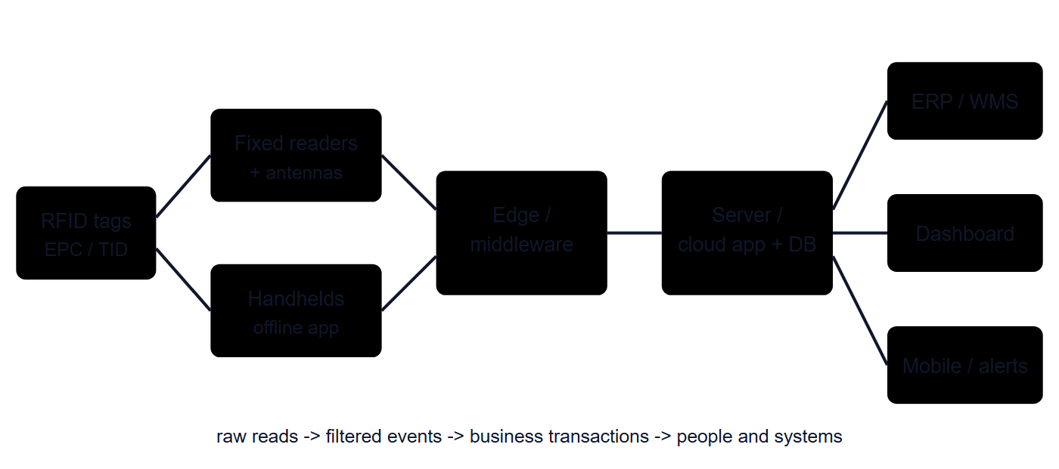
How RFID software works, end to end
MINDWARE
• Every RFID system, from a small library to a national toll network, follows roughly the same flow of data.
• 1. The reader produces raw reads
• A UHF reader (in India, operating in the 865-867 MHz band at up to 4 W EIRP, which typically means about 1 W from the reader into a moderate-gain antenna) inventories tags many times per second. Each read normally carries the tag's EPC, the antenna port that...
Indian RFID - Mindware | www.indianrfid.com | +91-9717122688 | gm@indianbarcode.com

Slide 4
How RFID software works, end to end (cont.)
MINDWARE
• 4. The database records the state and history
• Each accepted event updates the current state (where an item is, its status, who has it) and is stored in a history log. The history lets you answer questions later: when was this asset last seen, how many wash cycles has this towel done, which counter held...
• A note on handhelds
• Handheld readers follow the same chain, but the first three layers often run inside the mobile app itself. The app reads tags, removes duplicates, compares them with the expected list it downloaded before the count, and shows found, missing and extra items on...
• 5. Users and other systems consume the results
• Finally, the results appear on screens and reports, trigger notifications, and flow to the ERP, WMS, POS or accounting system as transactions such as goods receipts, stock transfers or count adjustments. Instructions also flow the other way: the ERP sends...
• Tip: When you evaluate software, ask the vendor to show a single tag's journey live: from the raw read in the reader log, to the filtered event, to the updated stock record, to the transaction that appears in your ERP. If they cannot show every step, find out...
Indian RFID - Mindware | www.indianrfid.com | +91-9717122688 | gm@indianbarcode.com

Slide 5
What every RFID software should integrate: the checklist
MINDWARE
• Not every project needs every module on day one, but a mature RFID platform should cover the following. Use this table as a requirement list when talking to vendors or planning your own development.
• Device and reader management - Configures readers (power, antennas, sessions, filters), monitors health and connectivity, manages firmware updates. ...
• Tag commissioning and encoding - Generates unique EPCs, writes them to tags, verifies the write, optionally locks memory. See RFID encoders explained...
• Label and tag printing - Sends print-and-encode jobs to RFID printers with barcode and human-readable text, and handles void tags. See the RFID...
• Item / asset master and EPC mapping - Links each EPC to an item, SKU or asset record with attributes (description, weight, serial, cost, owner). ...
• Barcode fallback - Lets users scan the barcode or QR printed on the tag when RFID cannot be read. - Damaged tags and difficult items always exist...
• Locations, zones and hierarchy - Models sites, buildings, floors, rooms, racks, counters or trays, and links readers and antennas to zones. - Reports...
Indian RFID - Mindware | www.indianrfid.com | +91-9717122688 | gm@indianbarcode.com

Slide 6
What every RFID software should integrate: the checklist (cont.)
MINDWARE
• Watch out: A long feature list is not the same as a working system. Ask which modules are standard and already running at customer sites, and which are "possible with customisation".
Indian RFID - Mindware | www.indianrfid.com | +91-9717122688 | gm@indianbarcode.com

Slide 7
How integration with ERP and other systems is done
MINDWARE
• Integration is usually the most underestimated part of an RFID project. There are three common directions of data flow:
• Masters into RFID: item, SKU, asset, location, customer and user lists flow from the ERP into the RFID application so tags can be commissioned...
• Documents into RFID: purchase orders, sales orders, transfer orders and pick lists tell the RFID system what is expected, so it can verify what is...
• Transactions back to ERP: confirmed receipts, dispatches, transfers and stock-count adjustments flow back so the financial books match physical...
• Common methods
• REST APIs and webhooks: the modern default; near real-time, easy to secure and monitor.
• Vendor connectors: standard interfaces or middleware for large ERPs such as SAP, Oracle or Microsoft Dynamics. These often need the ERP partner's...
Indian RFID - Mindware | www.indianrfid.com | +91-9717122688 | gm@indianbarcode.com

Slide 8
How integration with ERP and other systems is done (cont.)
MINDWARE
• File exchange: scheduled CSV, Excel or XML files. Simple and robust, but not real-time. Common with smaller accounting packages, including many Tally...
• Database or message queue integration: direct staging tables, or brokers such as MQTT for event streams.
• Reader-side protocols: LLRP (the standard reader protocol) and vendor SDKs connect readers to middleware; MQTT and HTTP are increasingly offered...
• Example: A distributor receives a carton-tagged shipment. The ERP has already sent the purchase order to the RFID application.
Indian RFID - Mindware | www.indianrfid.com | +91-9717122688 | gm@indianbarcode.com

Slide 9
Questions to ask an RFID software vendor
MINDWARE
• Which of our processes are covered by your standard product, and which need customisation?
• Which readers, handhelds and printers do you support, and are they from several manufacturers or one?
• Does the handheld app work offline, and how are conflicts resolved during sync?
• How do you integrate with our ERP or accounting system? Can you show a running example with the same system?
• Do you provide documented APIs and webhooks? Can we export all our data at any time in a standard format?
• Who owns the data and the EPC mapping? What happens to our data if we stop the subscription?
• Cloud, on-premise or both? Where is the data hosted, and how is it encrypted and backed up?
Indian RFID - Mindware | www.indianrfid.com | +91-9717122688 | gm@indianbarcode.com

Slide 10
Questions to ask an RFID software vendor (cont.)
MINDWARE
• How are user roles, audit trails and personal data handled, including our duties under the DPDP Act?
• What volumes (tags, events per second, users, sites) are you running today at your largest site?
• What are the licence model, annual support terms, response times and upgrade policy?
• Who configures readers on site and who fixes problems at 9 pm on a Saturday?
• Costs vary enormously with scope. As an indicative guide only, a ready-made application for a single site with standard reports may be a modest one-time licence or a monthly subscription, while a multi-site platform with ERP integration and custom workflows...
Indian RFID - Mindware | www.indianrfid.com | +91-9717122688 | gm@indianbarcode.com

Slide 11
Build vs buy
MINDWARE
• The middleware chapter discusses build-vs-buy for the filtering layer. For the complete application, the decision usually looks like this:
• Buy a ready product - Your process is common (retail stock, asset tracking, library, laundry, jewellery) and speed matters. - May need process...
• Buy and customise - The core fits but integrations, reports or a few workflows are specific to you. - Scope creep; insist on a written specification...
• Build in-house - RFID is part of your own product or the process is truly unique, and you have long-term developers. - Underestimating reader quirks...
• Most organisations do best with the middle path: a proven RFID platform for devices, encoding, counting and events, with custom integration and reporting built around it.
Indian RFID - Mindware | www.indianrfid.com | +91-9717122688 | gm@indianbarcode.com

Slide 12
Practical tips for a smooth software rollout
MINDWARE
• Clean the master data first. Duplicate SKUs, missing serials and wrong locations will be faithfully reproduced by RFID.
• Define the EPC scheme early so encoding, printing and integration all use the same format. See EPC encoding and memory .
• Pilot the full chain, including the ERP posting, not just the read rate.
• Write acceptance tests in business terms: "a count of 2,000 items matches expected within the agreed tolerance", "a gate exit alert arrives within...
• Plan for exceptions: unreadable tags, re-tagging, returns, items without tags and manual overrides, all with an audit trail.
• Train by role. Store staff need the handheld app; supervisors need exceptions and reports; IT needs device management and integration monitoring.
• Tip: Monitor integration as carefully as readers. A failed API call that leaves receipts unposted can do more damage than an offline antenna, because nobody notices until the books disagree with the shelves.
Indian RFID - Mindware | www.indianrfid.com | +91-9717122688 | gm@indianbarcode.com

Slide 13
Getting help with RFID software
MINDWARE
• Indian RFID, the RFID division of Mindware, provides RFID software and integration services, connecting readers, handhelds and printers with ERP, WMS, POS and accounting systems for Indian businesses. If you are planning a project, our RFID consulting team...
Indian RFID - Mindware | www.indianrfid.com | +91-9717122688 | gm@indianbarcode.com

Slide 14
Indian RFID - Mindware: from consultation to implementation
MINDWARE
1
Consultation
2
Site survey
3
Pilot
4
Supply
5
Encoding & software
6
Installation & training
7
Support & AMC
Mindware (New Delhi, since 1997) and its RFID division Indian RFID take your project from the first conversation to a working system - and support it after go-live.
Phone / WhatsApp: +91-9717122688 Email: gm@indianbarcode.com
S-4, Pankaj Plaza, Pocket-7, Plot-7, Dwarka Sector-12, New Delhi - 110078
www.indianrfid.com | Free guides: www.indianrfid.com/whitepapers
Indian RFID - Mindware | www.indianrfid.com | +91-9717122688 | gm@indianbarcode.com

