Slide 1

MINDWARE
RFID Printing & Encoding
An RFID printer does three jobs in one pass: it prints the visible label, writes data into the tag chip and checks that the tag works. This chapter explains how that process works, how to choose and set up a printer, where the...
Indian RFID - Mindware, New Delhi | From consultation to implementation
www.indianrfid.com/rfid-academy/rfid-printing-encoding | +91-9717122688 | gm@indianbarcode.com

Slide 2
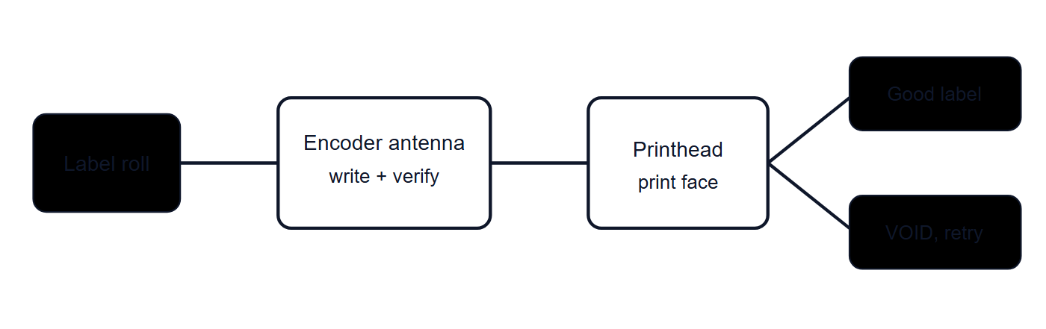
How an RFID printer works
MINDWARE
• An RFID printer is a thermal label printer with an RFID reader-encoder and a small antenna built into the media path. RFID labels - sometimes called smart labels - look like ordinary paper or synthetic labels, but each one carries an inlay (chip plus antenna)...
• Encode: the label stops, or slows, with its inlay over the encoder antenna, and the printer writes data such as the EPC into the chip memory.
• Verify: the printer reads the tag back and compares what it reads with what it wrote. If the tag does not respond, or the data does not match, the...
Indian RFID - Mindware | www.indianrfid.com | +91-9717122688 | gm@indianbarcode.com

Slide 3
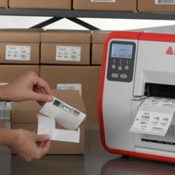
Desktop vs industrial RFID printers
MINDWARE
• RFID printers come in the same broad classes as barcode printers. The right class depends on volume, duty cycle and environment more than on the RFID function itself.
• Typical use - Offices, retail back rooms, small asset-tagging projects, sample runs - Warehouses, factories, distribution centres, continuous shifts
• Volume - Low to moderate daily volumes - High volumes and long continuous runs
• Media capacity - Smaller rolls, frequent changes - Large rolls and ribbons, fewer changes
• Build - Plastic housing, compact - Metal frame, built for dust and heavy use
• Options - Basic connectivity, sometimes cutter or peeler - Wider choice of print widths, resolutions, applicators, networking and on-metal media...
• Cost - Lower purchase cost - Higher purchase cost, lower cost per label at volume
Indian RFID - Mindware | www.indianrfid.com | +91-9717122688 | gm@indianbarcode.com

Slide 4
Desktop vs industrial RFID printers (cont.)
MINDWARE
• There are also print-and-apply systems that encode, print and apply labels automatically on a packing line, and mobile printers with RFID encoding for field use. Whatever the class, check that the printer supports the inlay types, label sizes and chip types...
Indian RFID - Mindware | www.indianrfid.com | +91-9717122688 | gm@indianbarcode.com

Slide 5
Inlay position and calibration
MINDWARE
• For reliable encoding, the inlay must sit in the right place relative to the printer's encoder antenna at the moment of writing. Two settings control this:
• Media settings: label length, gap or black-mark sensing, and label width, so the printer knows exactly where each label starts.
• Encoding (program) position: how far the label is advanced, or backed up, before the chip is written, and at what encoding power.
• Most RFID printers have an RFID calibration routine. The printer feeds labels, tries to encode at a range of positions and power levels, and selects the best combination for that media.
• The inlay's location within the label is called its placement or offset , and the distance from one inlay to the next along the roll is the inlay pitch . Printer manufacturers publish which inlays, placements and minimum pitches each model supports.
• Tip: Ask your label supplier for a media specification sheet that states the inlay model, chip, position within the label, pitch, face stock and adhesive. Keep it with the printer settings, so that the same combination can be reordered and recalibrated...
Indian RFID - Mindware | www.indianrfid.com | +91-9717122688 | gm@indianbarcode.com

Slide 6
Void and defective tag handling
MINDWARE
• Not every inlay works. A small proportion can be dead from manufacture, and others are damaged by rough handling, static, bending or crushing.
• The printer tries to write and verify the tag.
• If the tag fails, it retries a set number of times, sometimes adjusting power.
• If it still fails, the printer overstrikes the label - prints a VOID pattern or text across it - so it cannot be used by mistake.
• It then repeats the same job on the next label, so the data sequence is not lost.
• After a configurable number of consecutive failures, the printer stops and reports an error, because repeated failures usually point to a setting or...
• Monitor the void rate - voided labels as a percentage of labels printed. A low, steady rate is normal; a sudden rise signals a calibration, media or hardware issue.
Indian RFID - Mindware | www.indianrfid.com | +91-9717122688 | gm@indianbarcode.com

Slide 7
Void and defective tag handling (cont.)
MINDWARE
• Watch out: If voided labels are left in the rewind or the output tray near the printer, their tags may still respond to readers nearby and create phantom reads in your system. Remove them from the area and, where possible, physically destroy the inlay.
Indian RFID - Mindware | www.indianrfid.com | +91-9717122688 | gm@indianbarcode.com

Slide 8
Encoding data from ERP and label software
MINDWARE
• What goes into the chip should be decided by the data design, not by the person at the printer. In a well-run system:
• The ERP, WMS or asset system holds the master data: product code, batch, asset number or shipment details.
• Label design software or middleware takes that data, converts it to the EPC format chosen (for example an SGTIN or SSCC-based EPC, or a...
• Every EPC that must be unique - most item-level and asset schemes - gets a serial number from a controlled source, so no two tags carry the same code.
• After printing, the printer or software reports which EPCs were written successfully, and this encoding log is stored for reconciliation.
• Printers are driven by their command languages, which include commands to set up RFID parameters, write data to a memory bank, and read data back. Most organisations do not write these commands by hand; they configure templates in label software or integrate...
• Locking and passwords
Indian RFID - Mindware | www.indianrfid.com | +91-9717122688 | gm@indianbarcode.com

Slide 9
Encoding data from ERP and label software (cont.)
MINDWARE
• Encoding can also set an access password, a kill password and lock states for memory banks. Locking prevents the EPC from being changed later by someone with a reader.
Indian RFID - Mindware | www.indianrfid.com | +91-9717122688 | gm@indianbarcode.com

Slide 10
Label design: barcode, human-readable and RFID
MINDWARE
• An RFID label should still work as a normal label. Good designs combine three layers of identification:
• Barcode (linear or 2D) carrying the same identifier, or a related one, as a fallback when RFID cannot be read.
• Human-readable text so people can identify the item without any device.
• RFID inlay carrying the EPC, plus an optional RFID emblem so staff know the label contains a tag.
• Avoid printing a barcode directly over the chip. The chip forms a small bump, which can cause print voids and also puts extra printhead pressure on...
• Leave the inlay area free of heavy, dense graphics where possible.
• Choose face stock and ribbon to suit the environment: synthetic face and resin ribbon for moisture, abrasion and chemicals; paper with wax or...
Indian RFID - Mindware | www.indianrfid.com | +91-9717122688 | gm@indianbarcode.com

Slide 11
Label design: barcode, human-readable and RFID (cont.)
MINDWARE
• For metal items, use on-metal RFID labels designed for printing, not a standard inlay - see UHF RFID labels for the label types available.
Indian RFID - Mindware | www.indianrfid.com | +91-9717122688 | gm@indianbarcode.com

Slide 12
Pre-encoded batches vs on-demand printing
MINDWARE
• Where it happens - Label converter or service bureau, before delivery - At your site, when each label is needed
• Best for - Large runs with predictable data, such as asset numbering series or retail tags applied at source - Variable data: shipments, work orders...
• Equipment on site - None for encoding; ordinary application - RFID printer, software and trained users
• Flexibility - Low - data fixed in advance - High - any data, any time
• Data linkage - Supplier provides a file of EPCs that must be imported and linked to items - Linkage created automatically at print time
• Risks - Lost or mixed rolls break sequences; duplicate-file errors - Printer downtime stops labelling; needs calibration discipline
• Many projects use both: pre-encoded labels for high-volume, predictable items and an on-site printer for exceptions, replacements and variable data.
Indian RFID - Mindware | www.indianrfid.com | +91-9717122688 | gm@indianbarcode.com

Slide 13
Pre-encoded batches vs on-demand printing (cont.)
MINDWARE
• Example: A company tagging 20,000 fixed assets orders pre-encoded, pre-printed asset labels in a numbered series for the initial tagging drive, so field teams only need handheld readers. It keeps one RFID printer at head office to issue labels for new...
Indian RFID - Mindware | www.indianrfid.com | +91-9717122688 | gm@indianbarcode.com

Slide 14
Common problems and fixes
MINDWARE
• Adjacent-tag encoding (the wrong label is written, or the neighbouring tag also responds) - Encoder field reaching the next inlay, usually with short...
• Wrong inlay pitch or position - Media not matching the printer's supported inlays or settings from a previous roll - Load correct media settings, run...
• High void rate on a new roll - Damaged inlays, different chip or inlay from the previous batch, or no recalibration - Recalibrate; test sample labels...
• Read verification failures with good inlays - Encoding power too low or too high, wrong memory bank or data length in the job - Check job template...
• Faded or patchy print over the inlay - Chip bump under the printhead; wrong ribbon or heat setting - Move print fields away from the chip; adjust...
• Ribbon wrinkle or media drift - Ribbon tension, head pressure or worn platen roller - Adjust tension and pressure, clean or replace platen, use the...
Indian RFID - Mindware | www.indianrfid.com | +91-9717122688 | gm@indianbarcode.com

Slide 15
Quality control
MINDWARE
• A simple quality-control routine keeps printing reliable:
• Incoming media check: on each new batch, confirm the inlay type matches the specification and test a sample with a handheld reader.
• Calibrate on change: run RFID calibration for every new media type or batch.
• Keep verification on: never disable read-after-write verification to "speed up" printing.
• Track void rate: record it per shift or per roll, and investigate trends.
• Audit sample labels: read finished labels with a handheld to confirm the EPC matches the barcode and the system record.
• Test in the application: periodically check that labels applied to products still read at the real read points, not just in the printer.
Indian RFID - Mindware | www.indianrfid.com | +91-9717122688 | gm@indianbarcode.com

Slide 16
Quality control (cont.)
MINDWARE
• Store media properly: in original packaging, away from heat, humidity and sharp bends, which can crack inlay antennas.
• Maintain the printer: clean the printhead and platen, and keep firmware at a version supported by your label software.
• Before committing to a label and printer combination, make sure the tag itself has passed the tests in RFID site survey and tag testing . Printing a perfect label is of little value if the tag cannot be read on the product.
Indian RFID - Mindware | www.indianrfid.com | +91-9717122688 | gm@indianbarcode.com

Slide 17
Indian RFID - Mindware: from consultation to implementation
MINDWARE
1
Consultation
2
Site survey
3
Pilot
4
Supply
5
Encoding & software
6
Installation & training
7
Support & AMC
Mindware (New Delhi, since 1997) and its RFID division Indian RFID take your project from the first conversation to a working system - and support it after go-live.
Phone / WhatsApp: +91-9717122688 Email: gm@indianbarcode.com
S-4, Pankaj Plaza, Pocket-7, Plot-7, Dwarka Sector-12, New Delhi - 110078
www.indianrfid.com | Free guides: www.indianrfid.com/whitepapers
Indian RFID - Mindware | www.indianrfid.com | +91-9717122688 | gm@indianbarcode.com

