Slide 1

MINDWARE
RFID Frequencies: LF, HF, UHF & Microwave
RFID operates in several frequency bands, and the band decides range, speed, behaviour near metal and water, cost and which standards apply. This chapter explains LF, HF (including NFC), UHF and microwave RFID, lists the regional...
Indian RFID - Mindware, New Delhi | From consultation to implementation
www.indianrfid.com/rfid-academy/rfid-frequencies | +91-9717122688 | gm@indianbarcode.com

Slide 2
Why frequency matters
MINDWARE
• "RFID" is not one technology but a family of systems working at very different radio frequencies. The frequency decides how the reader and tag couple (magnetically or by radio waves), how far a tag can be read, how fast data moves, how many tags can be read...
• LF (low frequency) : 125 kHz and 134.2 kHz
• HF (high frequency) : 13.56 MHz, including NFC
• UHF (ultra-high frequency) : 860-960 MHz for passive tags, plus 433 MHz for many active tags
• Microwave : mainly 2.45 GHz, and 5.8 GHz in some toll systems
• As explained in How RFID Works , LF and HF systems use inductive (magnetic near-field) coupling, while UHF and microwave systems use radio waves and backscatter (or an active transmitter). That single difference explains most of the behaviour described below.
Indian RFID - Mindware | www.indianrfid.com | +91-9717122688 | gm@indianbarcode.com

Slide 3
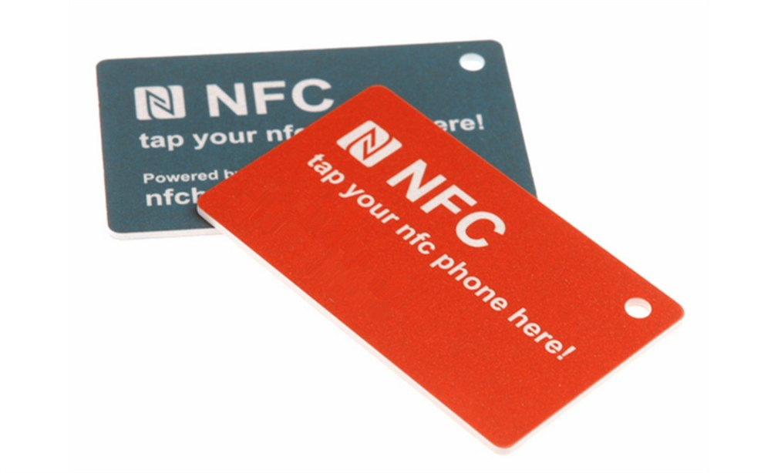
LF RFID: 125 kHz and 134.2 kHz
MINDWARE
• Low-frequency RFID is the oldest commercial band. Tags use a coil antenna, often wound copper wire around a ferrite core, which is why LF tags are relatively thick for their size.
• Range : typically up to about 10 cm for cards and key fobs; up to around a metre with large antennas and larger tags, for example in livestock...
• Data rate : low, typically a few kilobits per second, so reading is slower and only one or a few tags can be handled at a time.
• Metal and water : the long wavelength passes through water, soil and animal tissue well, and LF tolerates nearby metal better than other bands...
• Standards : ISO 11784/11785 define the code structure and air interface for animal identification at 134.2 kHz (FDX-B and HDX technologies). ISO...
• Typical uses : pet and livestock identification (glass capsule implants, ear tags, boluses), car immobiliser keys, legacy door access cards, some...
• Watch out: Many older 125 kHz access cards transmit a fixed ID with no encryption and can be copied with inexpensive tools. For new access-control projects, prefer secure HF credentials with mutual authentication and encryption.
Indian RFID - Mindware | www.indianrfid.com | +91-9717122688 | gm@indianbarcode.com

Slide 4
HF RFID: 13.56 MHz and NFC
MINDWARE
• HF RFID at 13.56 MHz uses flat printed or etched coil antennas, so tags can be thin labels, cards and stickers. It is a single worldwide frequency, which simplifies global deployment.
• ISO/IEC 14443 (proximity)
• Designed for contactless smart cards with a range typically up to about 10 cm. Chips range from simple memory types to secure microprocessors that run cryptography.
• ISO/IEC 15693 (vicinity)
• Designed for longer HF range, typically tens of centimetres and up to about a metre with large gate antennas, at lower data rates. Used for library books, document and file tracking, ski passes, some pharmaceutical and laboratory sample labels, and industrial...
• NFC (Near Field Communication)
• NFC is a set of standards (including ISO/IEC 18092 and NFC Forum specifications) built on 13.56 MHz HF technology for very short-range interaction, typically up to about 4 cm. It is compatible with ISO/IEC 14443 and, in most phones, ISO/IEC 15693 tags.
Indian RFID - Mindware | www.indianrfid.com | +91-9717122688 | gm@indianbarcode.com

Slide 5
HF RFID: 13.56 MHz and NFC (cont.)
MINDWARE
• Metal and water : HF works well near water and the human body. Metal close behind the coil disrupts the magnetic field; tags with a ferrite layer are...
• Multiple tags : HF anti-collision handles several tags in the field, but it is slower than UHF for bulk reading.
Indian RFID - Mindware | www.indianrfid.com | +91-9717122688 | gm@indianbarcode.com

Slide 6
UHF RFID: 860-960 MHz
MINDWARE
• Passive UHF RFID, branded as RAIN RFID and standardised as EPC Gen2 / ISO/IEC 18000-63 , is the fastest-growing segment of RFID and the backbone of supply-chain, retail, logistics and asset tracking.
• Range : typically several metres with fixed readers, up to about 10 metres or more for good labels in clean conditions; a few metres with handheld...
• Speed : high data rates and an efficient anti-collision protocol allow hundreds of tags per second.
• Tag cost : the lowest of any band for simple labels, because the antenna is a single-layer printed or etched dipole.
• Metal and water : the main weakness. Water absorbs UHF energy and metal reflects and detunes it. Special on-metal tags, tags designed for liquids...
• Typical uses : retail apparel, warehouse cartons and pallets, returnable containers, IT and fixed asset tracking, vehicle identification (including...
• Regional UHF bands
Indian RFID - Mindware | www.indianrfid.com | +91-9717122688 | gm@indianbarcode.com

Slide 7
UHF RFID: 860-960 MHz (cont.)
MINDWARE
• The UHF spectrum is allocated differently in each country, so readers must be configured for the local band and power limit. Main allocations for passive UHF RFID include:
• India - 865-867 MHz - Licence-exempt for RFID under WPC rules, up to 4 W EIRP
• Europe - 865-868 MHz - Higher-power RFID channels between 865.6 and 867.6 MHz (ETSI EN 302 208)
• USA, Canada, Mexico - 902-928 MHz - Frequency hopping, up to 4 W EIRP
• China - 920.5-924.5 MHz - A lower band around 840.5-844.5 MHz is also allocated
• Japan - Around 916.7-920.9 MHz - Licensing conditions depend on power level
• Australia - Around 920-926 MHz - Check current local class licence
Indian RFID - Mindware | www.indianrfid.com | +91-9717122688 | gm@indianbarcode.com

Slide 8
Microwave RFID: 2.45 GHz and 5.8 GHz
MINDWARE
• Microwave RFID mostly uses 2.45 GHz (the same unlicensed band as Wi-Fi and Bluetooth), standardised in ISO/IEC 18000-4. Passive microwave tags exist but are rare; most microwave RFID is active or battery-assisted, used for long-range vehicle identification...
• Strengths : small antennas, high data rates, long range when active.
• Weaknesses : strongly absorbed by water and the human body, crowded band with interference from Wi-Fi and other devices, higher tag cost.
• Related technologies such as Bluetooth Low Energy beacons and ultra-wideband (UWB) location tags are often used alongside or instead of active RFID for real-time location; these are compared in RFID vs Barcode vs NFC vs BLE .
Indian RFID - Mindware | www.indianrfid.com | +91-9717122688 | gm@indianbarcode.com

Slide 9
Frequency comparison at a glance
MINDWARE
• The figures below are typical for common passive tags (active where stated). Real results depend on the specific tag, reader, antenna and environment.
• Coupling - Inductive (magnetic) - Inductive (magnetic) - Radio wave, backscatter - Radio wave; mostly active
• Typical range - Up to about 10 cm; up to about 1 m with large antennas - Up to about 10 cm (cards, NFC); up to about 1 m (vicinity) - Several metres...
• Data rate - Low - Medium - High - High
• Bulk reading - Poor; one or a few tags - Moderate - Excellent; hundreds per second - Good
• Near water - Very good - Good - Poor without special tags - Poor
• Near metal - Fair - Fair; needs ferrite tags on metal - Poor without on-metal tags - Poor to fair
Indian RFID - Mindware | www.indianrfid.com | +91-9717122688 | gm@indianbarcode.com

Slide 10
Frequency comparison at a glance (cont.)
MINDWARE
• Indicative costs vary widely with volume, chip, form factor and conversion, and are given only as a rough guide.
Indian RFID - Mindware | www.indianrfid.com | +91-9717122688 | gm@indianbarcode.com

Slide 11
How to choose a frequency
MINDWARE
• Work through these questions in order. The first one that gives a firm answer often settles the choice.
• Is a standard or ecosystem already set? Animal ID points to LF ISO 11784/11785. Transit, payments and secure ID point to HF ISO/IEC 14443. Retail...
• How far away must the tag be read? A deliberate tap means LF or HF; a doorway, conveyor or shelf several metres away means UHF; tens of metres or...
• How many tags at once, and how fast? Counting a carton of 100 garments or a moving pallet calls for UHF.
• What are the items made of? Liquids, animals or the human body favour LF or HF, though modern UHF tags designed for these materials often work with...
• What is the budget per tag and per read point? For millions of low-value items, the low cost of UHF labels usually wins. For a few hundred high-value...
• Is security important? If data must be protected cryptographically, secure HF chips are the mature choice; UHF chips with authentication features...
Indian RFID - Mindware | www.indianrfid.com | +91-9717122688 | gm@indianbarcode.com

Slide 12
How to choose a frequency (cont.)
MINDWARE
• Example: A hospital might use three bands at once: HF ISO/IEC 14443 cards for secure staff access, UHF Gen2 tags for tracking equipment, linen and files through doorways, and NFC tags that nurses tap with a phone to log a task. Choosing a band per use case...
• Once you have chosen a band, the next decision is the tag itself: passive or active, which memory type and which form factor. That is the subject of the next chapter, Types of RFID Tags .
Indian RFID - Mindware | www.indianrfid.com | +91-9717122688 | gm@indianbarcode.com

Slide 13
Indian RFID - Mindware: from consultation to implementation
MINDWARE
1
Consultation
2
Site survey
3
Pilot
4
Supply
5
Encoding & software
6
Installation & training
7
Support & AMC
Mindware (New Delhi, since 1997) and its RFID division Indian RFID take your project from the first conversation to a working system - and support it after go-live.
Phone / WhatsApp: +91-9717122688 Email: gm@indianbarcode.com
S-4, Pankaj Plaza, Pocket-7, Plot-7, Dwarka Sector-12, New Delhi - 110078
www.indianrfid.com | Free guides: www.indianrfid.com/whitepapers
Indian RFID - Mindware | www.indianrfid.com | +91-9717122688 | gm@indianbarcode.com

