Slide 1

MINDWARE
RFID Encoders Explained: How RFID Chips Are Encoded
Encoding is the step that turns a blank RFID tag into a useful identity by writing data into its chip, protecting it with passwords and locking it. This chapter explains what encoding really involves for UHF, HF/NFC and LF tags...
Indian RFID - Mindware, New Delhi | From consultation to implementation
www.indianrfid.com/rfid-academy/rfid-encoders-explained | +91-9717122688 | gm@indianbarcode.com

Slide 2
What "encoding" an RFID chip actually means
MINDWARE
• A new tag already has a factory identifier and usually a default EPC, but nothing meaningful to your business. Encoding (also called programming, commissioning or writing) is the process of putting your data into the chip and protecting it so it stays correct...
• Depending on the tag technology, encoding can include several separate operations:
• Reading the factory identifier - the TID on UHF chips or the UID on HF chips. It is locked by the chip maker; encoders only read it.
• Writing the identity - the EPC number on UHF tags, an NDEF record on NFC tags, or data blocks on HF and LF tags.
• Writing user memory - optional extra data such as a batch number, maintenance date or asset details, on chips that have user memory.
• Setting passwords - an access password that protects locked memory and a kill password that can permanently disable a UHF tag.
• Locking - making memory write-protected (lock) or permanently write-protected (permalock).
Indian RFID - Mindware | www.indianrfid.com | +91-9717122688 | gm@indianbarcode.com

Slide 3
What "encoding" an RFID chip actually means (cont.)
MINDWARE
• The steps differ by frequency band. For a refresher on the chips themselves see RFID Chips Explained .
Indian RFID - Mindware | www.indianrfid.com | +91-9717122688 | gm@indianbarcode.com

Slide 4
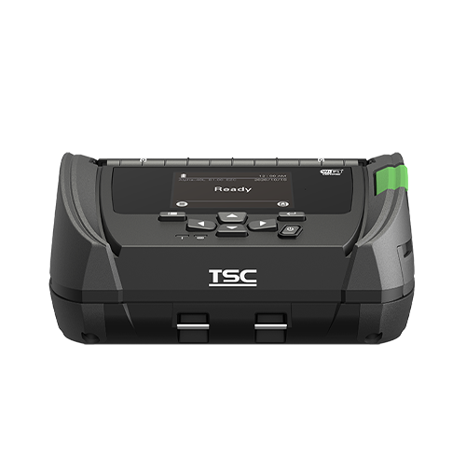
How UHF, HF/NFC and LF tags are encoded
MINDWARE
• UHF EPC Gen2 (ISO/IEC 18000-63)
• A Gen2 chip has four memory banks: Reserved (kill and access passwords, 32 bits each), EPC (a CRC, the Protocol Control or PC word, and the EPC number itself), TID (factory identifier, read-only) and optional User memory. Encoding a UHF tag means writing the...
• The PC word contains length bits that tell readers how many words of EPC to return. If you change the EPC length - for example from a 96-bit to a 128-bit number on a chip that supports longer EPCs - the PC length bits must be updated too, otherwise readers...
• HF and NFC (13.56 MHz)
• NTAG and other NFC Forum Type 2 tags - memory is organised in small pages. Encoding usually means writing an NDEF message (a URL, text or vCard) that...
• MIFARE Classic - memory is divided into sectors, each protected by two keys (Key A and Key B) and access bits that control what each key may do....
• ICODE and other ISO/IEC 15693 tags - memory is a series of blocks (commonly 4 bytes each). Encoding writes the blocks and can set fields such as AFI...
Indian RFID - Mindware | www.indianrfid.com | +91-9717122688 | gm@indianbarcode.com

Slide 5
How UHF, HF/NFC and LF tags are encoded (cont.)
MINDWARE
• LF (125-134 kHz)
• Many LF tags are simply read-only. An EM4100 -type chip, for example, comes with a fixed factory ID that cannot be changed.
Indian RFID - Mindware | www.indianrfid.com | +91-9717122688 | gm@indianbarcode.com

Slide 6
What data gets encoded
MINDWARE
• The chip only stores bits; your data standard gives them meaning. Common choices:
• SGTIN-96 - a GS1 product code (company prefix plus item reference) followed by a unique serial number. The standard choice for retail and apparel...
• SSCC-96 - identifies a logistics unit such as a carton or pallet.
• GRAI and GIAI - identify returnable assets and fixed assets respectively, widely used in asset tracking.
• Custom serials - in closed systems (a single factory, a library, a hospital) many projects simply write their own number scheme. Use a GS1 scheme...
• TID-based serialisation - because every chip TID is unique, some systems derive the EPC serial from the TID, or store the TID alongside the EPC in a...
• The bit-level maths of how a GTIN and serial become a 96-bit SGTIN - header, filter, partition and so on - is covered with a worked example in EPC Encoding & Tag Memory , so it is not repeated here.
Indian RFID - Mindware | www.indianrfid.com | +91-9717122688 | gm@indianbarcode.com

Slide 7
What data gets encoded (cont.)
MINDWARE
• India tip: To encode GS1 numbers such as SGTIN or SSCC you need your own GS1 company prefix, which Indian companies obtain from GS1 India. Exporters are often required to encode to their buyer's specification - a particular EPC scheme, filter value, chip type...
Indian RFID - Mindware | www.indianrfid.com | +91-9717122688 | gm@indianbarcode.com

Slide 8
Step-by-step: encoding a UHF Gen2 tag
MINDWARE
• Whether it happens inside an RFID printer or on a desktop encoder, a well-designed UHF encoding job follows the same sequence:
• Isolate one tag. Reduce transmit power and use a short-range antenna so only one tag is energised, and/or use the Gen2 Select command with a mask...
• Read the TID. This confirms a tag is present, identifies the chip model (and therefore its memory size and features) and gives a unique reference for...
• Get the data. Request the next EPC from the encoding software or database, which reserves that serial so it cannot be issued twice.
• Write the EPC words. Write the new EPC into the EPC bank, and update the PC length bits if the EPC length changes.
• Write user memory if the application needs it.
• Verify. Read the EPC (and user memory) back and compare it with what was intended. A write command that reports success is not proof - always read...
Indian RFID - Mindware | www.indianrfid.com | +91-9717122688 | gm@indianbarcode.com

Slide 9
Step-by-step: encoding a UHF Gen2 tag (cont.)
MINDWARE
• Write passwords. Set the access password and, if used, the kill password. Never leave them at the default all-zero value if you plan to lock.
• Lock. Lock or permalock the EPC bank, passwords and user memory according to your data policy.
• Log. Record TID, EPC, time, operator or station and result, and mark the serial as used.
• Why "adjacent tag encoding" happens
• The most embarrassing encoding error is writing the right data to the wrong tag - the tag next to the intended one on a roll, a stack or a tray. It happens because UHF energy spreads well beyond the antenna: if power is too high, the antenna is not...
• Watch out: Locking is not a formality. A permalocked tag can never be changed, so a wrong EPC that is permalocked becomes scrap.
Indian RFID - Mindware | www.indianrfid.com | +91-9717122688 | gm@indianbarcode.com

Slide 10
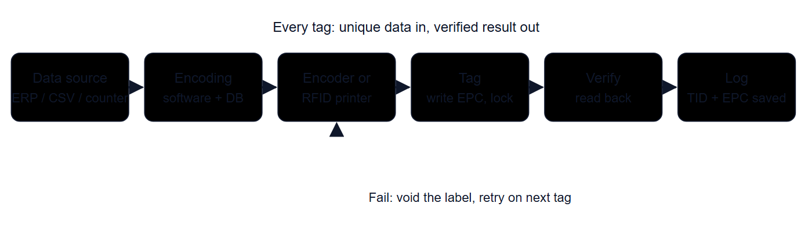
How an RFID encoder works
MINDWARE
• An RFID encoder is an RFID reader/writer combined with an antenna designed for very short range and software that controls what gets written. Most readers can write tags; an encoder is simply optimised for reliably writing one tag at a time.
• The RF side
• Writing to a passive chip's memory takes more energy than reading it, and the write operation needs a clean, uninterrupted link for longer. In practice this means that the reliable write range is noticeably shorter than the read range for the same tag and...
Indian RFID - Mindware | www.indianrfid.com | +91-9717122688 | gm@indianbarcode.com

Slide 11
How an RFID encoder works (cont.)
MINDWARE
• The data side
• The radio part is only half the job. The other half is making sure every tag gets correct, unique data:
• Data source - EPCs and user data come from the ERP or WMS, from label-design software, from a CSV file or from a serial counter. Data should never be...
• Encoding database - a central record of which serials have been issued, so two stations or two shifts can never write the same EPC.
• Verification and logging - every tag is read back, and the TID-to-EPC pairing is stored.
• How an RFID printer encodes
• An RFID printer packs the whole flow into one pass. As each label reaches the built-in encoder antenna, the printer reads the TID, writes the EPC and user data, reads it back, sets passwords and locks, and then prints the visible text, barcode and logo.
Indian RFID - Mindware | www.indianrfid.com | +91-9717122688 | gm@indianbarcode.com

Slide 12
Types of RFID encoders available worldwide
MINDWARE
• Encoders range from a pocket-sized NFC phone to a production line writing inlays at very high speed. The table summarises the main categories found around the world; multi-protocol desktop units handle UHF, HF and LF in one box, and embedded modules let...
• Desktop USB / Ethernet encoder - Small reader/writer with a built-in near-field antenna; UHF, HF/NFC, LF or multi-protocol versions - Encoding cards...
• RFID printer-encoder - Thermal label printer with built-in encoder; desktop, mid-range and industrial classes - On-demand labels for shipping...
• Handheld reader as mobile encoder - Handheld UHF/HF reader running an encoding app, writing at very low power - Tagging fixed assets in place...
• Fixed reader in an encoding station - Fixed reader plus a near-field or shielded antenna, often in a tunnel or box, driven by PC software - Encoding...
• Inline / conveyor and print-and-apply - Encoder or RFID print engine mounted on a conveyor or applicator, triggered by sensors - Packing lines...
• Roll-to-roll encoding and verification - Multiple encoder heads on a converting or inlay line, with marking or cutting of failed inlays - Label...
Indian RFID - Mindware | www.indianrfid.com | +91-9717122688 | gm@indianbarcode.com

Slide 13
Types of RFID encoders available worldwide (cont.)
MINDWARE
• RFID printer-encoders
• The major label-printer manufacturers - including Zebra, TSC/Printronix, SATO and Honeywell - offer RFID-enabled versions of their desktop, mid-range and industrial thermal printers. See the RFID printers range for current options.
• Handheld and fixed readers
• Most handheld RFID readers can write tags through an app. They suit assets already installed in place, but the app must reduce power and confirm the TID before writing.
• Inline, print-and-apply and roll-to-roll systems
• For high volumes, encoding moves onto the line. Inline encoders write tags already applied to cartons or garments as they pass on a conveyor; print-and-apply systems print, encode, verify and apply labels automatically.
Indian RFID - Mindware | www.indianrfid.com | +91-9717122688 | gm@indianbarcode.com

Slide 14
Regional versions: why the frequency band matters
MINDWARE
• HF (13.56 MHz) and LF encoders are essentially the same worldwide, but UHF encoders are sold in regional versions because each region allocates a different slice of the UHF band:
• Europe (ETSI): 865-868 MHz.
• India: 865-867 MHz, up to 4 W EIRP (1 W transmitter power), licence-exempt under WPC rules.
• USA, Canada and much of the Americas (FCC): 902-928 MHz.
• Japan: a band around 916-921 MHz.
• China: 920-925 MHz (with an additional 840-845 MHz allocation).
• A tag usually works across the whole 860-960 MHz range, but the encoder's radio is certified for a specific region. Using an FCC unit in India means transmitting outside the permitted band, which is not legal, and its coupler may be tuned for the wrong...
Indian RFID - Mindware | www.indianrfid.com | +91-9717122688 | gm@indianbarcode.com

Slide 15
How to choose an RFID encoder
MINDWARE
• Volume and speed - a few hundred tags a week is desktop-encoder or desktop-printer territory; thousands per shift needs an industrial printer or...
• Tag type - labels on a roll suit printers; cards, hard tags, key fobs and on-metal tags usually need a desktop encoder or station; tags already fixed...
• Frequency and protocol - UHF Gen2, HF ISO 15693, ISO 14443/NFC or LF; a multi-protocol unit helps if you handle several.
• Data source and integration - check that the encoder works with your ERP, WMS or label software, and that serials can come from a central database.
• Verification and logging - insist on read-back verification and an exportable log, especially when encoding for retail or export customers.
• Budget (indicative only) - NFC phones and desktop encoders sit at the low end, RFID desktop and industrial printers in the middle, and inline...
• Example: A garment exporter in Tiruppur must ship every item with an SGTIN-96 encoded swing tag to the buyer's specification. For a few thousand items a day, an industrial RFID printer linked to the order system works well; once volumes grow, ordering...
Indian RFID - Mindware | www.indianrfid.com | +91-9717122688 | gm@indianbarcode.com

Slide 16
Indian RFID - Mindware: from consultation to implementation
MINDWARE
1
Consultation
2
Site survey
3
Pilot
4
Supply
5
Encoding & software
6
Installation & training
7
Support & AMC
Mindware (New Delhi, since 1997) and its RFID division Indian RFID take your project from the first conversation to a working system - and support it after go-live.
Phone / WhatsApp: +91-9717122688 Email: gm@indianbarcode.com
S-4, Pankaj Plaza, Pocket-7, Plot-7, Dwarka Sector-12, New Delhi - 110078
www.indianrfid.com | Free guides: www.indianrfid.com/whitepapers
Indian RFID - Mindware | www.indianrfid.com | +91-9717122688 | gm@indianbarcode.com

