Slide 1

MINDWARE
RFID Antennas & Inlays
Antennas do most of the work in an RFID system: the tag antenna captures energy and sends data back, and the reader antenna shapes where tags can be read. This chapter explains tag antenna design, inlay types, reader antenna...
Indian RFID - Mindware, New Delhi | From consultation to implementation
www.indianrfid.com/rfid-academy/rfid-antennas-inlays | +91-9717122688 | gm@indianbarcode.com

Slide 2
Why antennas matter so much
MINDWARE
• In a passive RFID system, the tag has no battery. Every bit of energy that wakes the chip must be captured by the tag antenna , and every reply must travel back through it.
• This chapter covers both sides: the antenna inside the tag (and the inlay it is built on), and the antennas connected to readers. For how they fit into the whole system, see Components of an RFID System .
Indian RFID - Mindware | www.indianrfid.com | +91-9717122688 | gm@indianbarcode.com

Slide 3
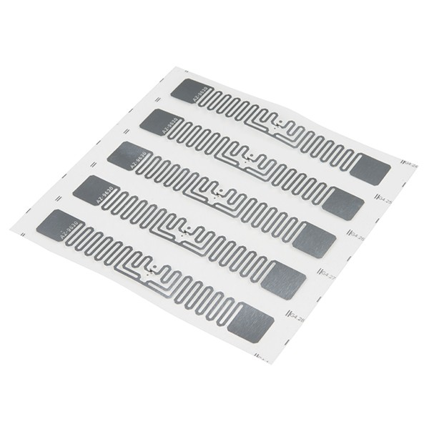
Tag antenna design basics
MINDWARE
• The type of tag antenna depends on the frequency band and how the tag couples to the reader.
• Coils for LF and HF
• LF (125-134 kHz) and HF (13.56 MHz) tags work in the reader's near field by inductive (magnetic) coupling, much like a transformer. Their antennas are coils - copper wire windings in LF glass tags and key fobs, or etched or printed spiral loops in HF cards...
• Dipoles and meanders for UHF
• UHF tags (860-960 MHz) mostly work in the reader's far field , capturing propagating radio waves. Their antennas are based on the dipole .
• Near-field loops for UHF
• Some small UHF tags use a loop antenna designed to couple magnetically to a near-field reader antenna at very short range. These are used for item-level tagging in confined spaces, such as pharmaceutical vials, or where reading must be restricted to a few...
Indian RFID - Mindware | www.indianrfid.com | +91-9717122688 | gm@indianbarcode.com

Slide 4
Tag antenna design basics (cont.)
MINDWARE
• Matching and size
• A UHF chip's input impedance is complex (mainly capacitive), so the antenna is designed with the conjugate (inductive) impedance to transfer maximum power. This is why antennas are designed around specific chips.
Indian RFID - Mindware | www.indianrfid.com | +91-9717122688 | gm@indianbarcode.com

Slide 5
Tuning and detuning near metal, liquids and people
MINDWARE
• A tag antenna is tuned to resonate at a target frequency in a particular environment. Put it on a different material and the resonance shifts.
• Plastics, cardboard, glass and wood have a dielectric effect that lowers the resonant frequency slightly. Tags are often tuned to allow for typical...
• Liquids and water-rich materials (drinks, food, human bodies) absorb UHF energy and strongly detune antennas. HF and LF are much less affected.
• Metal reflects radio waves and effectively short-circuits the electric field at its surface, so a standard UHF label laid flat on metal will usually...
• Solutions include on-metal tags , which either use a foam or plastic spacer to lift the antenna off the surface or use antenna designs (such as patch-type structures) that treat the metal as a ground plane. Some chips also include self-tuning circuits that...
• Watch out: Datasheet read ranges are usually measured in free space or on a reference material. On your product, range may be much shorter.
Indian RFID - Mindware | www.indianrfid.com | +91-9717122688 | gm@indianbarcode.com

Slide 6
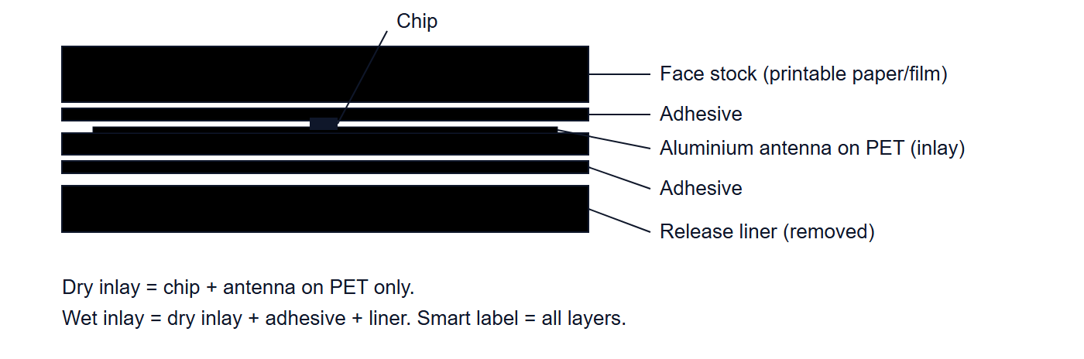
Inlays: dry, wet and paper face
MINDWARE
• An inlay is the core of most labels: a chip bonded to an aluminium (sometimes copper or printed silver) antenna on a thin PET film. Converters turn inlays into finished products in several forms:
• Dry inlay: chip and antenna on film with no adhesive. Used when the inlay will be laminated or embedded, for example in cards, tickets, books...
• Wet inlay: a dry inlay with pressure-sensitive adhesive on one side, supplied on a release liner. It can be applied directly but has no printable...
Indian RFID - Mindware | www.indianrfid.com | +91-9717122688 | gm@indianbarcode.com

Slide 7
Reader antennas: polarisation, gain and beamwidth
MINDWARE
• Circular vs linear polarisation
• Polarisation describes the orientation of the radio wave's electric field. Most UHF tag antennas are linearly polarised dipoles: they respond best when aligned with the field.
• A linear polarised reader antenna radiates a field in one plane. A tag aligned with that plane gets maximum energy; a tag rotated 90 degrees gets...
• A circular polarised antenna rotates the field as it propagates, so a linear tag receives energy in any rotation around the antenna axis. The...
• Use circular antennas where tag orientation varies - dock doors, conveyors, retail exits. Use linear antennas where tags are always oriented the same way - tags on a conveyor in a fixed position, vehicle windshields, shelves with consistently placed items.
• Gain
• Gain measures how strongly the antenna focuses energy in its main direction compared with a reference. Linear antenna gain is quoted in dBi (relative to an isotropic radiator); circular antenna gain is often quoted in dBic .
Indian RFID - Mindware | www.indianrfid.com | +91-9717122688 | gm@indianbarcode.com

Slide 8
Reader antennas: polarisation, gain and beamwidth (cont.)
MINDWARE
• Beamwidth
• Beamwidth (usually the -3 dB beamwidth) is the angle over which the antenna delivers at least half its peak power. Higher gain means narrower beamwidth.
• Regulatory power limits
• Regulations limit radiated power, not just reader output. India's de-licensed 865-867 MHz band (governed by WPC notifications) allows up to 4 W EIRP (1 W transmitter power); Europe's ETSI rules allow 2 W ERP in a similar band; the USA FCC rules allow 4 W EIRP...
Indian RFID - Mindware | www.indianrfid.com | +91-9717122688 | gm@indianbarcode.com

Slide 9
Near-field and far-field antennas
MINDWARE
• Around any antenna there is a near-field region, dominated by magnetic and electric fields stored close to the antenna, and a far-field region, where a propagating wave has formed. At UHF the boundary is only a few centimetres to a few tens of centimetres...
• Far-field antennas (standard panels) are for reading at a distance: dock doors, ceilings, vehicle lanes, warehouse portals.
• Near-field antennas create a strong, contained field just above their surface. They are used in smart shelves, point-of-sale pads, desktop encoders...
• Common antenna formats
• Portal / panel antenna - Dock doors, gates, conveyor tunnels - Usually circular, mid-to-high gain, mounted in pairs or more
• Ceiling antenna - Retail floors, overhead zones - Low-profile, often wide beam; sometimes steerable array systems
• Shelf / mat antenna - Smart shelves, cabinets, counters - Low power, near-field or short-range far-field
Indian RFID - Mindware | www.indianrfid.com | +91-9717122688 | gm@indianbarcode.com

Slide 10
Near-field and far-field antennas (cont.)
MINDWARE
• Long-range directional - Vehicle access, yards - High gain, narrow beam, often linear
• Embedded / module antenna - Handhelds, desktop readers, kiosks - Integrated in the device housing
• Browse the formats we supply on our RFID antennas page.
Indian RFID - Mindware | www.indianrfid.com | +91-9717122688 | gm@indianbarcode.com

Slide 11
Cables, connectors and loss
MINDWARE
• Every connector and metre of coaxial cable between the reader and antenna loses some power - in both directions, since the tag's weak reply returns through the same cable. Loss is cumulative in dB, and each 3 dB of loss halves the power reaching the antenna.
• Cable type matters. Thin, flexible cables lose much more per metre at UHF than thicker low-loss cables. As a rough guide, thin cables can lose around...
• Keep runs short. Mount the reader close to its antennas rather than running long cables back to a rack.
• Connectors: readers commonly use reverse-polarity TNC (RP-TNC) or SMA connectors; antennas often use N-type, TNC or SMA. Use the right cable ends...
• Weatherproof outdoor joints and avoid sharp bends or crushing, which damage cable and raise loss.
• Example: A reader set to 30 dBm feeds an antenna through 10 m of thin cable losing 0.4 dB per metre. That is 4 dB lost before the antenna and 4 dB again on the tag's return path.
Indian RFID - Mindware | www.indianrfid.com | +91-9717122688 | gm@indianbarcode.com

Slide 12
Antenna placement tips
MINDWARE
• Face the antenna toward where tags will be , not toward where you hope they will be. Consider the height of tags on cartons and people.
• Use multiple antennas for portals - typically two to four per dock door, on both sides or above - so tags facing any direction are covered.
• Keep antennas away from large metal objects directly in front of them, and be aware that metal racks and doors cause reflections that extend or...
• Separate neighbouring read zones by distance, angle, lower power or RF-absorbing material to prevent stray reads from the next door or lane.
• Mount rigidly. Antennas that move or vibrate create unpredictable zones.
• Test with real tagged items at the actual speeds and orientations, and adjust power and angle before fixing the installation. Our site survey chapter...
• Antennas work together with readers - the next chapter, RFID Readers Explained , covers the electronics that drive them.
Indian RFID - Mindware | www.indianrfid.com | +91-9717122688 | gm@indianbarcode.com

Slide 13
Indian RFID - Mindware: from consultation to implementation
MINDWARE
1
Consultation
2
Site survey
3
Pilot
4
Supply
5
Encoding & software
6
Installation & training
7
Support & AMC
Mindware (New Delhi, since 1997) and its RFID division Indian RFID take your project from the first conversation to a working system - and support it after go-live.
Phone / WhatsApp: +91-9717122688 Email: gm@indianbarcode.com
S-4, Pankaj Plaza, Pocket-7, Plot-7, Dwarka Sector-12, New Delhi - 110078
www.indianrfid.com | Free guides: www.indianrfid.com/whitepapers
Indian RFID - Mindware | www.indianrfid.com | +91-9717122688 | gm@indianbarcode.com

