Slide 1

MINDWARE
How RFID Works
This chapter follows a single RFID read from start to finish: how a passive tag is powered, how it answers without a transmitter, and how a reader sorts out hundreds of tags replying at once. It also explains sessions, inventory...
Indian RFID - Mindware, New Delhi | From consultation to implementation
www.indianrfid.com/rfid-academy/how-rfid-works | +91-9717122688 | gm@indianbarcode.com

Slide 2
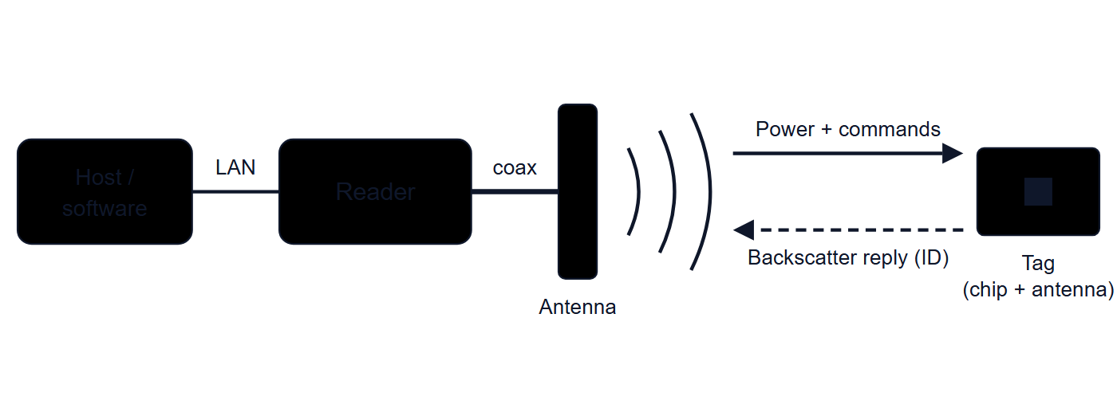
The big picture
MINDWARE
• An RFID read is a short conversation. The reader speaks first and supplies all the energy; the tag only listens and responds.
Indian RFID - Mindware | www.indianrfid.com | +91-9717122688 | gm@indianbarcode.com

Slide 3
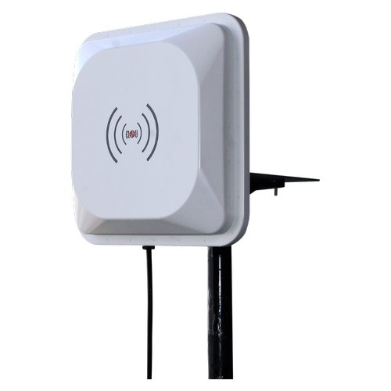
The read cycle, step by step
MINDWARE
• Here is what happens in a typical passive UHF read using the EPC Gen2 (ISO/IEC 18000-63) protocol. LF and HF systems follow the same overall pattern with different details.
• The reader energises its antenna. It transmits a continuous wave (an unmodulated carrier) on a channel in the permitted band, for example within...
• The tag powers up. When a tag enters the field, its antenna captures a small amount of energy. A rectifier and charge pump on the chip convert it...
• The reader issues commands. It modulates the carrier to send commands: optionally a Select to pick which tags should take part (for example only tags...
• Anti-collision sorts the tags out. Tags reply in random time slots so the reader can deal with them one at a time (explained below).
• The singled-out tag sends its identity. After the reader acknowledges it, the tag backscatters its Protocol Control (PC) bits, its EPC and a CRC...
• Optional memory access. If the application needs more than the EPC, the reader can ask the tag for a handle and then read or write other memory...
Indian RFID - Mindware | www.indianrfid.com | +91-9717122688 | gm@indianbarcode.com

Slide 4
The read cycle, step by step (cont.)
MINDWARE
• The reader reports. For each read the reader records the EPC plus useful metadata: which antenna port saw it, the time, the received signal strength...
• Software turns reads into events. Middleware removes duplicates, applies rules and tells the business system something meaningful, such as "carton...
• All of this happens in milliseconds. A good reader in a well-designed setup can inventory hundreds of tags per second.
Indian RFID - Mindware | www.indianrfid.com | +91-9717122688 | gm@indianbarcode.com

Slide 5
Two ways to talk: inductive coupling and backscatter
MINDWARE
• LF and HF: inductive (near-field) coupling
• Low-frequency (125/134.2 kHz) and high-frequency (13.56 MHz) systems use coils. The reader's coil creates an alternating magnetic field.
• To reply, the tag uses load modulation : it switches a load across its coil on and off. Because the two coils are coupled, this slightly changes the current in the reader's coil, and the reader detects that change.
• The magnetic near field weakens very rapidly with distance, roughly with the cube of the distance, so inductive systems have short, well-defined ranges: typically a few centimetres for cards and up to around a metre for large HF vicinity antennas. That short...
• UHF: far-field backscatter
• At UHF (860-960 MHz) the wavelength is about 33-35 cm, and beyond a few centimetres from the antenna the reader's signal is a travelling radio wave. A UHF tag uses a dipole-like antenna tuned to that wavelength to capture energy from the wave.
• To reply, the chip switches its antenna's impedance between two states. In one state the antenna absorbs most of the incoming energy; in the other it reflects more of it.
Indian RFID - Mindware | www.indianrfid.com | +91-9717122688 | gm@indianbarcode.com

Slide 6
Two ways to talk: inductive coupling and backscatter (cont.)
MINDWARE
• Tip: In Gen2, reader-to-tag commands are sent with amplitude modulation using pulse-interval encoding (PIE), and tags reply using FM0 or Miller subcarrier encoding. Miller modes are slower but more robust in noisy, multi-reader environments; the reader's "RF...
Indian RFID - Mindware | www.indianrfid.com | +91-9717122688 | gm@indianbarcode.com

Slide 7
Anti-collision: reading many tags at once
MINDWARE
• If every tag in the field answered at the same moment, the replies would overlap and the reader would decode nothing. This is called a collision .
• Slotted ALOHA in plain words
• Imagine a teacher asking a class of 30 students to call out their roll numbers, but each student must first secretly pick a random number between 0 and 31 and speak only when the teacher counts to that number. Most counts will have zero or one student...
• The Gen2 Q algorithm
• The reader sends Query containing a value Q between 0 and 15. Each participating tag picks a random slot number between 0 and (2 to the power Q)...
• Tags whose counter is 0 reply immediately with a 16-bit random number (RN16). The rest wait.
• If exactly one RN16 arrives cleanly, the reader sends ACK with that number. The tag recognises its own number and sends its PC, EPC and CRC.
Indian RFID - Mindware | www.indianrfid.com | +91-9717122688 | gm@indianbarcode.com

Slide 8
Anti-collision: reading many tags at once (cont.)
MINDWARE
• The reader sends QueryRep to move to the next slot. Every waiting tag decrements its counter, and any tag reaching 0 replies.
• If a slot is empty, nothing is lost but a little time. If it has a collision, the reader skips it; those tags will get another chance.
• The reader watches the pattern. Many collisions mean Q is too small for the number of tags, so it raises Q with QueryAdjust . Many empty slots mean Q...
• Example: With about 50 tags in the field, Q = 6 gives 64 slots, so most slots hold zero or one tag. With Q = 2 there would be only 4 slots and nearly every slot would collide; with Q = 12 there would be 4,096 slots, almost all empty, which wastes time.
• HF standards use their own anti-collision methods. ISO/IEC 14443 Type A, for instance, resolves collisions bit by bit on the card's unique ID, while ISO/IEC 15693 uses 16 time slots selected by bits of the tag ID.
Indian RFID - Mindware | www.indianrfid.com | +91-9717122688 | gm@indianbarcode.com

Slide 9
Sessions and inventoried flags
MINDWARE
• When a reader counts a large group of tags, it does not want the same strong tags answering again and again while weaker tags never get a turn. Gen2 handles this with inventoried flags .
• The sessions differ in how long the flag "remembers" after the tag loses power or is left alone:
• S0 : the flag resets to A as soon as the tag loses power, so in practice tags in S0 keep answering. Good for watching a single tag continuously.
• S1 : the flag returns to A by itself after a short time (between about half a second and a few seconds), even if the tag is powered. Useful for tags...
• S2 and S3 : the flag persists for at least a couple of seconds after power is lost, often longer. Ideal for counting large populations, because each...
• The Select command can also set a separate SL flag, so a reader can focus on a subset of tags such as one product family or one shipment. Two readers covering the same area are normally configured to use different sessions so they do not reset each other's...
• Watch out: A common setup mistake is using S0 with a single target for a stock count. S0 flags reset whenever a tag loses power, which happens often as the reader switches antennas or channels, so strong, nearby tags keep re-entering the round and crowd out...
Indian RFID - Mindware | www.indianrfid.com | +91-9717122688 | gm@indianbarcode.com

Slide 10
What limits a read?
MINDWARE
• A passive read only succeeds if two links both work. The forward link must deliver enough power to wake the tag, and the reverse link must bring a strong enough reply back to the reader.
• Transmit power and regulations : each country caps reader output. In India's 865-867 MHz band the limit is up to 4 W EIRP. More power means more...
• Tag sensitivity : chips and antenna designs differ; a more sensitive tag reads further.
• Orientation and polarisation : a simple dipole tag barely responds when it points straight at the antenna along its own axis. Circularly polarised...
• Materials : metal reflects and detunes; water and other liquids absorb UHF energy. Tags made for these surfaces, or spacing the tag away from them...
• Distance and the environment : signal strength falls with distance, and reflections from walls, racks and floors create dead spots (nulls) and...
• Cable and connector losses : long or thin coaxial cables waste reader power before it reaches the antenna.
Indian RFID - Mindware | www.indianrfid.com | +91-9717122688 | gm@indianbarcode.com

Slide 11
What limits a read? (cont.)
MINDWARE
• Interference and other readers : nearby readers and other radio sources can overwhelm the faint tag reply; dense-reader modes and channel planning...
• Speed and dwell time : a tag moving quickly past an antenna must be powered and read in a short window, especially when many tags pass together.
• All of these are explored in depth in RFID Read Range and Performance , and choosing between LF, HF and UHF is covered in RFID Frequencies .
Indian RFID - Mindware | www.indianrfid.com | +91-9717122688 | gm@indianbarcode.com

Slide 12
Putting it into practice
MINDWARE
• For a working engineer, the theory translates into a few habits. Choose the frequency and tag to suit the item and its surroundings.
• Whether you use fixed readers at a doorway or handheld readers for cycle counts, the same read cycle is running underneath. Next, see how all the hardware and software pieces fit together in Components of an RFID System .
Indian RFID - Mindware | www.indianrfid.com | +91-9717122688 | gm@indianbarcode.com

Slide 13
Indian RFID - Mindware: from consultation to implementation
MINDWARE
1
Consultation
2
Site survey
3
Pilot
4
Supply
5
Encoding & software
6
Installation & training
7
Support & AMC
Mindware (New Delhi, since 1997) and its RFID division Indian RFID take your project from the first conversation to a working system - and support it after go-live.
Phone / WhatsApp: +91-9717122688 Email: gm@indianbarcode.com
S-4, Pankaj Plaza, Pocket-7, Plot-7, Dwarka Sector-12, New Delhi - 110078
www.indianrfid.com | Free guides: www.indianrfid.com/whitepapers
Indian RFID - Mindware | www.indianrfid.com | +91-9717122688 | gm@indianbarcode.com

