Slide 1

MINDWARE
Who Invented RFID? The History and the Father of RFID
RFID was not invented in one day by one person. It grew from radar and wartime identification, a 1948 theory of reflected power, a Soviet listening device, and a series of patents in the 1970s. This chapter tells the story - and...
Indian RFID - Mindware, New Delhi | From consultation to implementation
www.indianrfid.com/rfid-academy/history-of-rfid | +91-9717122688 | gm@indianbarcode.com

Slide 2
The short answer
MINDWARE
• RFID was not invented by one person in one moment. It was built up over about thirty years, from radar in the 1930s and 1940s to the first patented RFID tags in the early 1970s.
• Mario W. Cardullo - received a US patent in January 1973 for a passive radio transponder with rewritable memory . This is generally recognised as the...
• Charles Walton - an engineer who held a long series of RFID patents from the 1970s onward, including a 1983 patent for a portable radio-frequency...
• Behind them stand the radar pioneers, a scientist who described communication by reflected radio waves, and many teams in government labs and companies. Here is the full story.
Indian RFID - Mindware | www.indianrfid.com | +91-9717122688 | gm@indianbarcode.com

Slide 3
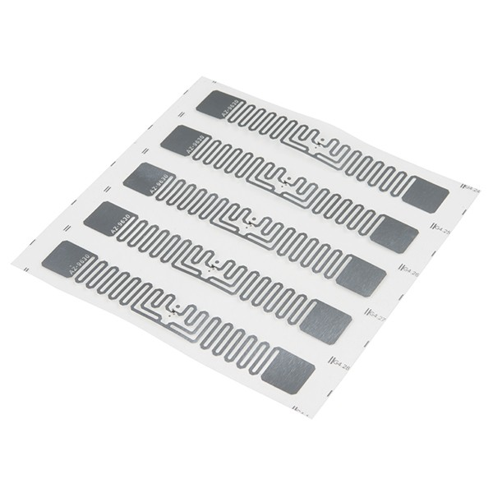
1930s-1940s: radar and Identification Friend or Foe
MINDWARE
• Radar, developed in several countries in the 1930s and led in Britain by Sir Robert Watson-Watt , could show an approaching aircraft but not whose aircraft it was. The answer was IFF (Identification Friend or Foe) : a transponder on friendly aircraft that...
Indian RFID - Mindware | www.indianrfid.com | +91-9717122688 | gm@indianbarcode.com

Slide 4
1945: Theremin's "Thing"
MINDWARE
• In 1945, Soviet inventor Leon Theremin designed a listening device hidden inside a carved wooden Great Seal presented to the US ambassador in Moscow. It had no battery: a cavity and antenna were "lit up" by a radio beam from outside, and sound vibrations...
Indian RFID - Mindware | www.indianrfid.com | +91-9717122688 | gm@indianbarcode.com

Slide 5
1948: Harry Stockman and reflected power
MINDWARE
• In October 1948, Harry Stockman published "Communication by Means of Reflected Power". He showed that information could be sent by changing how an object reflects a radio wave, instead of transmitting a new signal.
Indian RFID - Mindware | www.indianrfid.com | +91-9717122688 | gm@indianbarcode.com

Slide 6
1950s-1960s: experiments and anti-theft tags
MINDWARE
• Through the 1950s and 1960s engineers explored long-range transponders and radio identification. The first mass-market product appeared in shops: electronic article surveillance (EAS) , the anti-theft tags that sound an alarm at the door.
Indian RFID - Mindware | www.indianrfid.com | +91-9717122688 | gm@indianbarcode.com

Slide 7
1970s: the first true RFID tags
MINDWARE
• 1973 - Mario W. Cardullo is granted a US patent for an active and passive radio transponder with memory that could be rewritten . His proposals...
• 1973 - Charles Walton receives the first of his patents for a passive transponder used to unlock a door without a key. His later patents, including...
• 1970s - Los Alamos National Laboratory in the USA demonstrates passive tags read by modulated backscatter, for tracking livestock and vehicles. The...
Indian RFID - Mindware | www.indianrfid.com | +91-9717122688 | gm@indianbarcode.com

Slide 8
1980s-1990s: tolls, animals and access cards
MINDWARE
• Low-frequency tags became standard for animal identification, and electronic toll collection spread in the USA and Europe. HF (13.56 MHz) smart cards brought contactless access control, transport tickets and payments.
Indian RFID - Mindware | www.indianrfid.com | +91-9717122688 | gm@indianbarcode.com

Slide 9
1999-2004: the Electronic Product Code
MINDWARE
• In 1999 the Auto-ID Center was founded at the Massachusetts Institute of Technology (MIT), with researchers including Kevin Ashton , Sanjay Sarma and David Brock . Their idea: give every single item a unique number - the Electronic Product Code (EPC) - and...
Indian RFID - Mindware | www.indianrfid.com | +91-9717122688 | gm@indianbarcode.com

Slide 10
2010s-today: RAIN RFID and India
MINDWARE
• Passive UHF RFID is now known as RAIN RFID , and billions of tags are used every year in apparel, retail, logistics, healthcare, aviation and manufacturing. In India, FASTag - a passive UHF RFID windscreen tag - became mandatory for vehicles at national...
• Indian RFID in this story: Mindware, the parent of Indian RFID, has worked in barcode and auto-identification in New Delhi since 1997 - through the shift from barcodes to RFID. Today Indian RFID prints and encodes RFID labels in Delhi and trains engineers in...
Indian RFID - Mindware | www.indianrfid.com | +91-9717122688 | gm@indianbarcode.com

Slide 11
RFID timeline at a glance
MINDWARE
• 1930s-1940s - Radar and IFF transponders identify friendly aircraft
• 1945 - Leon Theremin's passive listening device ("The Thing")
• 1948 - Harry Stockman: "Communication by Means of Reflected Power"
• 1960s - Electronic article surveillance (1-bit anti-theft tags)
• 1973 - Mario Cardullo's patent for a rewritable passive transponder; Charles Walton's first door-entry transponder patent
• 1970s - Los Alamos demonstrates passive backscatter tags
Indian RFID - Mindware | www.indianrfid.com | +91-9717122688 | gm@indianbarcode.com

Slide 12
Indian RFID - Mindware: from consultation to implementation
MINDWARE
1
Consultation
2
Site survey
3
Pilot
4
Supply
5
Encoding & software
6
Installation & training
7
Support & AMC
Mindware (New Delhi, since 1997) and its RFID division Indian RFID take your project from the first conversation to a working system - and support it after go-live.
Phone / WhatsApp: +91-9717122688 Email: gm@indianbarcode.com
S-4, Pankaj Plaza, Pocket-7, Plot-7, Dwarka Sector-12, New Delhi - 110078
www.indianrfid.com | Free guides: www.indianrfid.com/whitepapers
Indian RFID - Mindware | www.indianrfid.com | +91-9717122688 | gm@indianbarcode.com

