Slide 1

MINDWARE
Jewellery Labels - Give Us the Size & Colour, We Make Them for Your Shop
For jewellery shops, showrooms and branches across India - printable on your barcode printer
Indian RFID - Mindware, New Delhi | From consultation to implementation
www.indianrfid.com/jewellery-labels-manufacturer | +91-9717122688 | gm@indianbarcode.com

Slide 2
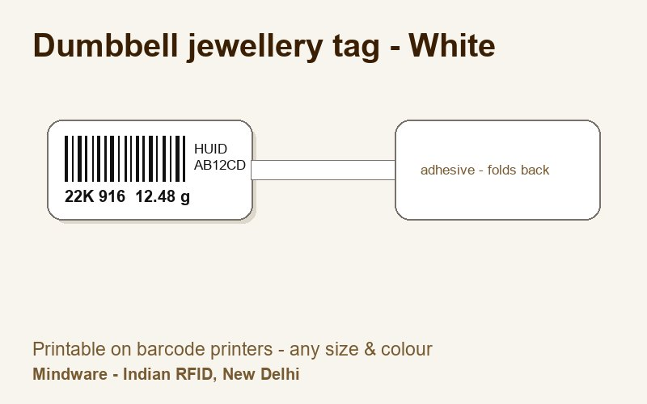
Variations of jewellery labels we make
MINDWARE
• Two printed heads joined by a thin tail that loops through the piece; the adhesive end folds back onto the printed head.
• A printed flag with one long tail that wraps around the item and sticks to itself.
• Two printed wings either side of a narrow neck - both faces show the barcode and price.
• Printed tag with a punched hole for a string, thread or elastic loop.
• Plain die-cut labels for boxes, trays, pouches and certificates.
• Small circular labels for earring cards, studs and price dots.
• Clear film labels that let the metal or stone show through.
Indian RFID - Mindware | www.indianrfid.com | +91-9717122688 | gm@indianbarcode.com

Slide 3
Variations of jewellery labels we make (cont.)
MINDWARE
• Jewellery tags with an RFID inlay inside - barcode printed for billing, RFID for stock audit in minutes.
Indian RFID - Mindware | www.indianrfid.com | +91-9717122688 | gm@indianbarcode.com

Slide 4

Our jewellery label products
MINDWARE
Indian RFID - Mindware | www.indianrfid.com | +91-9717122688 | gm@indianbarcode.com

Slide 5
Jewellery labels gallery - types and colours
MINDWARE
• Every jewellery label below is made to your size and colour and prints on standard thermal transfer barcode printers.
Indian RFID - Mindware | www.indianrfid.com | +91-9717122688 | gm@indianbarcode.com

Slide 6
Colours
MINDWARE
• White Yellow Gold metallic Silver metallic Pink Red Orange Green Blue Black Transparent
• Need another colour, a printed logo or a special shape? Tell us - we make it.
Indian RFID - Mindware | www.indianrfid.com | +91-9717122688 | gm@indianbarcode.com

Slide 7
Specifications
MINDWARE
• Material - Tear-proof synthetic (PP / PET) jewellery tag stock; transparent film for clear labels
• Adhesive - Permanent, on the fold-back end of tail and dumbbell tags
• Printing - Thermal transfer with resin ribbon - sweat, water and scratch resistant
• Barcode - Code 128 or Data Matrix with item code, gross / net weight, purity, HUID, tray
• Core / roll - 1 inch core rolls for desktop printers (other cores on request)
• RFID option - UHF inlay inside, printed and encoded by Indian RFID
Indian RFID - Mindware | www.indianrfid.com | +91-9717122688 | gm@indianbarcode.com

Slide 8
Printers & scanners for jewellery labels
MINDWARE
• 300 dpi thermal transfer printers for small, sharp barcodes - TSC , Zebra , GoDEX
• Resin ribbons (Mynds) matched to synthetic jewellery stock
• High-density 2D scanners for billing counters - see barcode scanners
• Printer set-up, label design and staff training by Mindware
• Printheads and paid service for your printers
• See how a store uses them: jewellery labels case study · RFID jewellery management
Indian RFID - Mindware | www.indianrfid.com | +91-9717122688 | gm@indianbarcode.com

Slide 9
Tell us your size & colour
MINDWARE
• We make jewellery labels for your shop, showroom or branch. Share the type, size, colour and quantity - we reply with samples and the price.
• 1 Send size, colour & quantity
• 2 Get samples & price
• 3 Labels made in New Delhi & delivered
Indian RFID - Mindware | www.indianrfid.com | +91-9717122688 | gm@indianbarcode.com

Slide 10
Indian RFID - Mindware: from consultation to implementation
MINDWARE
1
Consultation
2
Site survey
3
Pilot
4
Supply
5
Encoding & software
6
Installation & training
7
Support & AMC
Mindware (New Delhi, since 1997) and its RFID division Indian RFID take your project from the first conversation to a working system - and support it after go-live.
Phone / WhatsApp: +91-9717122688 Email: gm@indianbarcode.com
S-4, Pankaj Plaza, Pocket-7, Plot-7, Dwarka Sector-12, New Delhi - 110078
www.indianrfid.com | Free guides: www.indianrfid.com/whitepapers
Indian RFID - Mindware | www.indianrfid.com | +91-9717122688 | gm@indianbarcode.com

