Slide 1

MINDWARE
POS software & hardware: barcode, then RFID - a case study
A retail store on Mindware POS software and hardware - first with barcodes, then upgraded to RFID - in pictures.
Indian RFID - Mindware, New Delhi | From consultation to implementation
www.indianrfid.com/barcode-academy/pos-barcode-rfid-case-study | +91-9717122688 | gm@indianbarcode.com

Slide 2
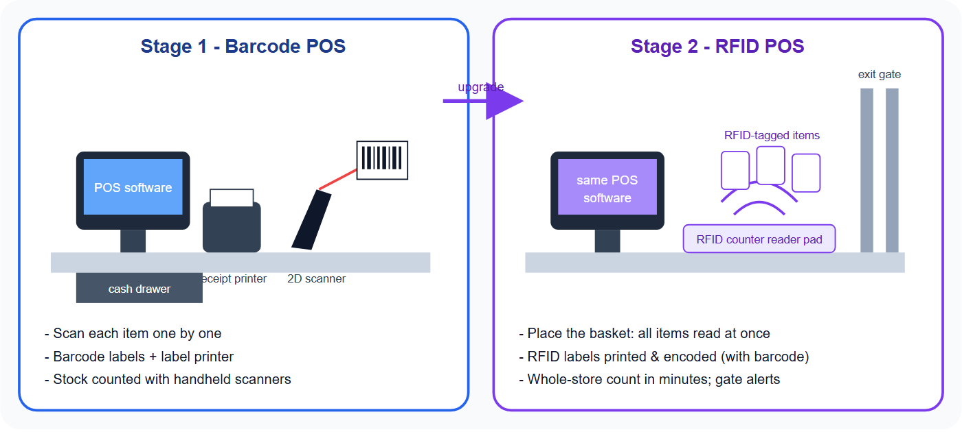
Stage 1 and Stage 2 - in pictures
MINDWARE
Indian RFID - Mindware | www.indianrfid.com | +91-9717122688 | gm@indianbarcode.com

Slide 3
The store
MINDWARE
• A multi-counter retail store (fashion, footwear, gifts or electronics) with a back room and a few thousand items. It wanted faster billing, correct prices, fewer stock mismatches and live reports for the owner.
Indian RFID - Mindware | www.indianrfid.com | +91-9717122688 | gm@indianbarcode.com

Slide 4
Stage 1: POS software and hardware with barcodes
MINDWARE
• POS software - billing, GST invoices, item master with barcodes, purchase and stock, discounts and loyalty, daily reports for the owner.
• POS hardware - POS terminal or billing PC, thermal receipt printer, cash drawer, customer display, and a 2D barcode scanner that also reads UPI QR...
• Labels - barcode price labels and hang tags printed in-store on a desktop label printer; stock labels from Indian Barcode .
• Stock - goods received by scanning; periodic stock counts with a cordless scanner or mobile computer.
• Set-up - installation, item import, label design, staff training and AMC by Mindware.
• Result: faster, error-free billing, consistent prices on shelf and in the system, and daily sales and stock reports.
Indian RFID - Mindware | www.indianrfid.com | +91-9717122688 | gm@indianbarcode.com

Slide 5
Stage 2: the same POS, upgraded to RFID
MINDWARE
• RFID labels and tags - printed and encoded by Indian RFID with the same item code and a unique serial; the barcode stays on the label as a backup.
• RFID at the counter - a counter reader pad reads every item in the basket at once; the POS software adds them to the bill.
• RFID handheld - counts the whole store and back room in minutes and finds missing items.
• Exit gate - alerts when an unbilled tagged item leaves the store.
• Same software, same hardware - the POS terminal, receipt printer and cash drawer stay; RFID is added to them.
• Result: quicker checkout for full baskets, near-real-time stock accuracy, fewer losses, and replenishment based on what is really on the shelf.
Indian RFID - Mindware | www.indianrfid.com | +91-9717122688 | gm@indianbarcode.com

Slide 6
Barcode POS vs RFID POS
MINDWARE
• Billing - Scan items one by one - Read the whole basket at once
• Labels - Barcode price labels and hang tags - RFID labels / hang tags with barcode printed
• Stock count - Scan each item - hours - RFID handheld - minutes
• Loss prevention - Staff checks - RFID exit gate alerts
• Hardware - POS terminal, receipt printer, cash drawer, scanner, label printer - Same, plus RFID reader pad, RFID printer, handheld, gate
• Cost - Lowest - Higher; pays back through stock accuracy and loss reduction
• See also: complete store & warehouse solutions · RFID vs barcode · RFID for jewellers
Indian RFID - Mindware | www.indianrfid.com | +91-9717122688 | gm@indianbarcode.com

Slide 7
Barcode POS vs RFID POS (cont.)
MINDWARE
• Get a POS quote Hire us as your consultant
Indian RFID - Mindware | www.indianrfid.com | +91-9717122688 | gm@indianbarcode.com

Slide 8
Indian RFID - Mindware: from consultation to implementation
MINDWARE
1
Consultation
2
Site survey
3
Pilot
4
Supply
5
Encoding & software
6
Installation & training
7
Support & AMC
Mindware (New Delhi, since 1997) and its RFID division Indian RFID take your project from the first conversation to a working system - and support it after go-live.
Phone / WhatsApp: +91-9717122688 Email: gm@indianbarcode.com
S-4, Pankaj Plaza, Pocket-7, Plot-7, Dwarka Sector-12, New Delhi - 110078
www.indianrfid.com | Free guides: www.indianrfid.com/whitepapers
Indian RFID - Mindware | www.indianrfid.com | +91-9717122688 | gm@indianbarcode.com

