Slide 1

MINDWARE
Jewellery labels: a pictorial case study
How a jewellery store tags, bills and audits with barcode jewellery tags from Indian Barcode - with pictures - and upgrades to RFID.
Indian RFID - Mindware, New Delhi | From consultation to implementation
www.indianrfid.com/barcode-academy/jewellery-barcode-labels-case-study | +91-9717122688 | gm@indianbarcode.com

Slide 2
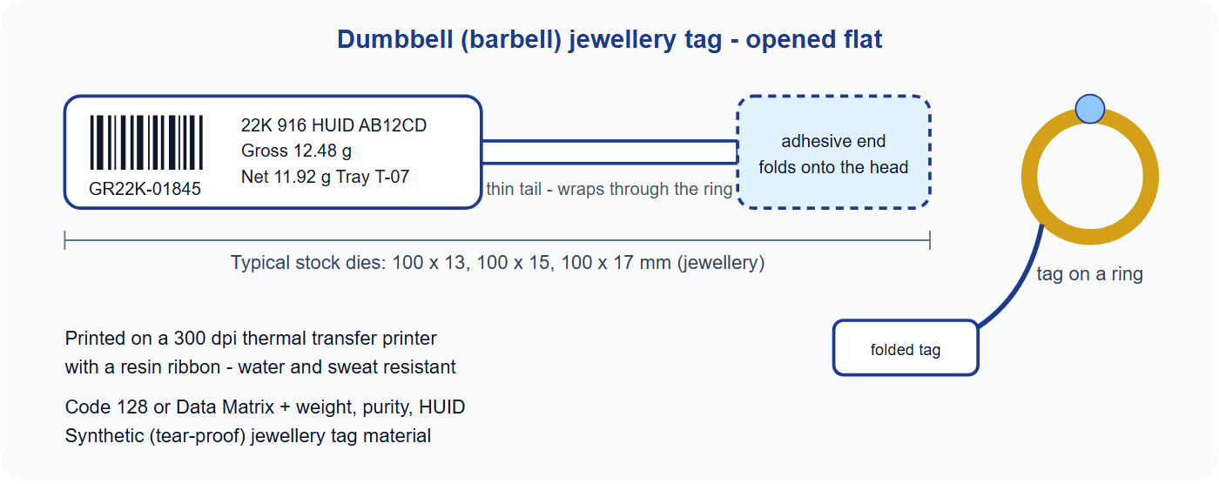
The jewellery tag - in pictures
MINDWARE
Indian RFID - Mindware | www.indianrfid.com | +91-9717122688 | gm@indianbarcode.com

Slide 3
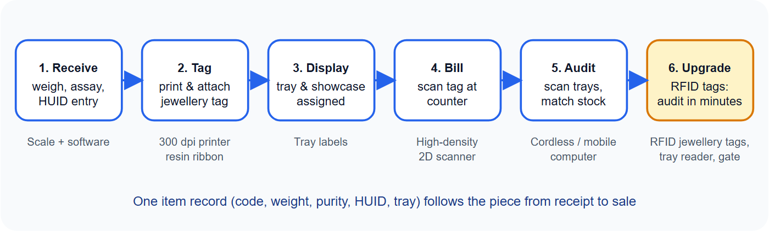
The jewellery store workflow - in pictures
MINDWARE
Indian RFID - Mindware | www.indianrfid.com | +91-9717122688 | gm@indianbarcode.com

Slide 4
The challenge
MINDWARE
• A showroom with thousands of rings, chains, earrings and bangles needs every piece identified with its weight, purity and HUID. Handwritten tags are slow and error-prone, ordinary paper labels tear and smudge with handling, and small items leave very little...
Indian RFID - Mindware | www.indianrfid.com | +91-9717122688 | gm@indianbarcode.com

Slide 5
The barcode solution from Indian Barcode / Indian RFID
MINDWARE
• Jewellery tags - synthetic, tear-proof dumbbell tags in stock die sizes (100 x 13, 100 x 15, 100 x 17 mm) for rings, chains and pendants; flat labels...
• Printer and ribbon - a 300 dpi thermal transfer printer with resin ribbon for small, sharp, sweat-resistant barcodes.
• Barcode and data - Code 128 or Data Matrix with the item code; weight, purity, HUID and tray printed as text, from the store's jewellery software.
• Scanners - high-density 2D scanners at billing counters; cordless or mobile computers for tray checks. See types of barcode scanners .
• Set-up and training - label design, printer calibration and staff training by Mindware.
Indian RFID - Mindware | www.indianrfid.com | +91-9717122688 | gm@indianbarcode.com

Slide 6
What changes in the store
MINDWARE
• Tagging new stock - Write each tag by hand - Print from the item record - consistent and readable
• Billing - Type the item code and weight - One scan fills code, weight and purity
• Tray check - Count and read every tag - Scan each piece and compare with the tray list
• Stock audit - Hours with paper lists - Faster scanning; exceptions shown by the software
• Next step - - - Upgrade to RFID jewellery management - audit a whole showroom in minutes
Indian RFID - Mindware | www.indianrfid.com | +91-9717122688 | gm@indianbarcode.com

Slide 7
From barcode to RFID
MINDWARE
• Many jewellers start with barcode tags and move to RFID jewellery tags when they want to audit trays and showcases without scanning piece by piece. The tag shape stays familiar; an RFID inlay is added inside and a barcode is still printed for billing.
• Order jewellery tags RFID for jewellers
Indian RFID - Mindware | www.indianrfid.com | +91-9717122688 | gm@indianbarcode.com

Slide 8
Indian RFID - Mindware: from consultation to implementation
MINDWARE
1
Consultation
2
Site survey
3
Pilot
4
Supply
5
Encoding & software
6
Installation & training
7
Support & AMC
Mindware (New Delhi, since 1997) and its RFID division Indian RFID take your project from the first conversation to a working system - and support it after go-live.
Phone / WhatsApp: +91-9717122688 Email: gm@indianbarcode.com
S-4, Pankaj Plaza, Pocket-7, Plot-7, Dwarka Sector-12, New Delhi - 110078
www.indianrfid.com | Free guides: www.indianrfid.com/whitepapers
Indian RFID - Mindware | www.indianrfid.com | +91-9717122688 | gm@indianbarcode.com

