Slide 1

MINDWARE
Grocery chain automated with barcodes: a case study
How a multi-store grocery chain automates billing, pricing, weighing, receiving and stock with barcode solutions - in pictures.
Indian RFID - Mindware, New Delhi | From consultation to implementation
www.indianrfid.com/barcode-academy/grocery-chain-barcode-case-study | +91-9717122688 | gm@indianbarcode.com

Slide 2
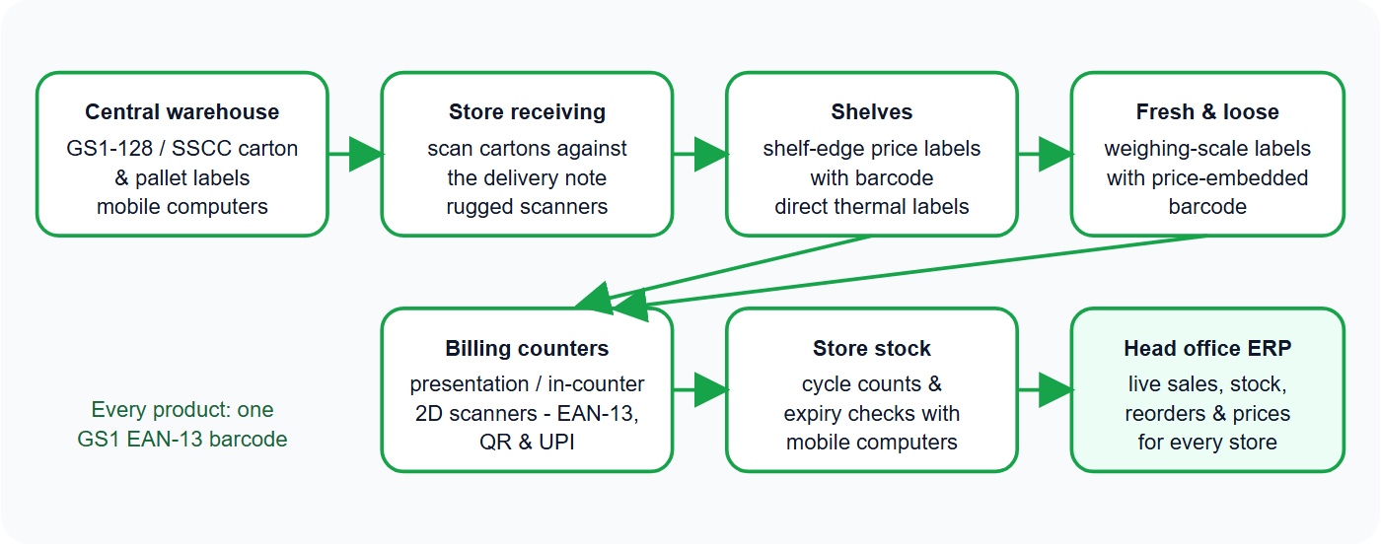
The grocery barcode flow - in pictures
MINDWARE
Indian RFID - Mindware | www.indianrfid.com | +91-9717122688 | gm@indianbarcode.com

Slide 3
The challenge
MINDWARE
• Long queues at billing, price mismatches between shelf and system, manual receiving at each store, losses from expired stock and no clear view of what is selling in which store.
Indian RFID - Mindware | www.indianrfid.com | +91-9717122688 | gm@indianbarcode.com

Slide 4
The barcode solution
MINDWARE
• GS1 barcodes on own-brand products - barcode registration and EAN-13 numbering for private labels.
• Billing counters - presentation and in-counter 2D scanners that read EAN-13, QR codes and UPI payment QR codes in any direction.
• Weighing scales - direct thermal scale labels with price-embedded barcodes for fruit, vegetables, dry fruits and bakery.
• Shelf-edge labels - barcoded price labels printed from the ERP whenever prices change.
• Warehouse and receiving - GS1-128 / SSCC carton and pallet labels, mobile computers for picking, dispatch and store receiving.
• Stock and expiry - cycle counts and near-expiry checks with mobile computers; GS1 DataBar / Data Matrix where batch and expiry are needed.
• Labels and ribbons - made by Indian Barcode in 168 stock die sizes , with Mynds ribbons and service across India.
Indian RFID - Mindware | www.indianrfid.com | +91-9717122688 | gm@indianbarcode.com

Slide 5
What changes
MINDWARE
• Billing - Typing codes, long queues - One scan per item; faster queues
• Prices - Shelf and system disagree - Shelf labels printed from the same price file
• Receiving - Manual counting at each store - Scan cartons against the delivery note
• Expiry - Found on the shelf too late - Near-expiry lists from batch and expiry data
• Head office - Reports days later - Live sales and stock for every store
• Next step for larger chains: RFID on high-value categories, cartons and returnable crates - see RFID warehouse management .
• Hire us as your barcode consultant
Indian RFID - Mindware | www.indianrfid.com | +91-9717122688 | gm@indianbarcode.com

Slide 6
Indian RFID - Mindware: from consultation to implementation
MINDWARE
1
Consultation
2
Site survey
3
Pilot
4
Supply
5
Encoding & software
6
Installation & training
7
Support & AMC
Mindware (New Delhi, since 1997) and its RFID division Indian RFID take your project from the first conversation to a working system - and support it after go-live.
Phone / WhatsApp: +91-9717122688 Email: gm@indianbarcode.com
S-4, Pankaj Plaza, Pocket-7, Plot-7, Dwarka Sector-12, New Delhi - 110078
www.indianrfid.com | Free guides: www.indianrfid.com/whitepapers
Indian RFID - Mindware | www.indianrfid.com | +91-9717122688 | gm@indianbarcode.com

