Slide 1

MINDWARE
Garment store chain on barcodes: a case study
Hang tags, MRP labels, size-wise stock and billing for a garment chain - in pictures - and the move to RFID.
Indian RFID - Mindware, New Delhi | From consultation to implementation
www.indianrfid.com/barcode-academy/garment-chain-barcode-case-study | +91-9717122688 | gm@indianbarcode.com

Slide 2
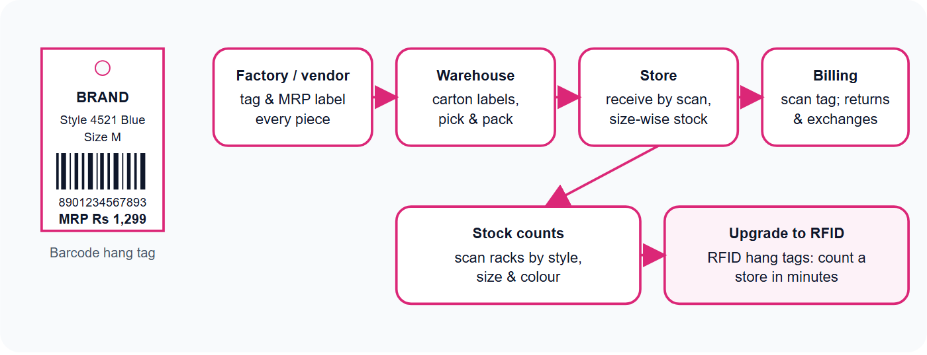
The garment barcode flow - in pictures
MINDWARE
Indian RFID - Mindware | www.indianrfid.com | +91-9717122688 | gm@indianbarcode.com

Slide 3
The challenge
MINDWARE
• Hundreds of styles in many sizes and colours, frequent price changes and sales, exchanges at billing, and stock that never matches the system - the right size is in the wrong store.
Indian RFID - Mindware | www.indianrfid.com | +91-9717122688 | gm@indianbarcode.com

Slide 4
The barcode solution
MINDWARE
• Hang tags and price labels - printed barcode hang tags and MRP stickers with style, size, colour and price; one EAN-13 or Code 128 per SKU.
• Care labels and carton labels - wash-care labels and GS1-128 carton labels for warehouse and store receiving.
• Printers and ribbons - thermal transfer printers with wax or wax-resin ribbons at factories and the warehouse; desktop printers in stores for...
• Scanners - 2D billing scanners that also read UPI QR codes; mobile computers for receiving, transfers and stock counts.
• Software link - labels printed from the ERP / POS item master, so every store sees the same SKU and price.
• Exporters - retailer-specific labels and RFID tags for buyers abroad, printed and encoded by Indian RFID.
Indian RFID - Mindware | www.indianrfid.com | +91-9717122688 | gm@indianbarcode.com

Slide 5
What changes
MINDWARE
• Billing & exchanges - Manual entry, wrong size or price - Scan the tag - correct SKU and price
• Receiving - Count pieces by hand - Scan cartons and pieces against the transfer
• Size-wise stock - Unknown until someone checks - Live stock by style, size and colour
• Sales & markdowns - Re-label by hand - Reprint price labels from the system
• Next step - - - RFID hang tags: full store count in minutes, faster billing
• Learn more about RFID for apparel in the exporters RFID guide , or order labels and tags .
• Hire us as your barcode consultant
Indian RFID - Mindware | www.indianrfid.com | +91-9717122688 | gm@indianbarcode.com

Slide 6
Indian RFID - Mindware: from consultation to implementation
MINDWARE
1
Consultation
2
Site survey
3
Pilot
4
Supply
5
Encoding & software
6
Installation & training
7
Support & AMC
Mindware (New Delhi, since 1997) and its RFID division Indian RFID take your project from the first conversation to a working system - and support it after go-live.
Phone / WhatsApp: +91-9717122688 Email: gm@indianbarcode.com
S-4, Pankaj Plaza, Pocket-7, Plot-7, Dwarka Sector-12, New Delhi - 110078
www.indianrfid.com | Free guides: www.indianrfid.com/whitepapers
Indian RFID - Mindware | www.indianrfid.com | +91-9717122688 | gm@indianbarcode.com

